Slide 1

On-Chip Diagnosis of Generalized Delay Failures using Compact Fault Dictionaries Matthew L. Beckler Advanced Chip Test Laboratory (ACTL) Department of Electrical and Computer Engineering Carnegie Mellon University Ph.D. Defense April 27, 2017
Committee:
Prof. Shawn Blanton (Advisor)
Prof. Ken Mai
Prof. Diana Marculescu
Prof. Subhasish Mitra

Slide 2
Motivation and Overview
Integrated Circuits (ICs) are very important in the modern, computerized world
Semiconductor fabrication processes are imperfect, and getting worse with scaling
Emerging applications (medical devices, autonomous vehicles) require robust operation
Periodic test and diagnosis of (pending) failures
New fault model, hierarchical fault dictionary, and on-chip diagnosis can provide failure localization to enable IC robustness
2
Notes:
Nowadays, computers are everywhere. In a recent article, Bloomberg Business estimated that over 60% of the world’s population uses a computing device daily. In 2014, Intel sold over 400 million CPUs, and around 14 billion ARM-based chips were sold. Computers are being added to every device around us, and computers are even being added _to_ us. Embedded devices like hearing aids and pacemakers are computers we put inside our bodies. Furthermore, self-driving vehicles and fly-by-wire airliners are basically now just large computers we put our bodies inside of. For all of these computer systems, I’d really like for them to work correctly, 100% of the time.
Here is the highest-level overview of the context of this work.
One approach to ensure reliability and robust operation is the periodic self test and diagnosis of any failures. With accelerated tests, we can even detect pending failures before they affect correct system operation.
In this work, we’ve developed a series of contributions all related to performing on-chip fault diagnosis to target the delay defects of scaled technologies, using compact dictionaries and an on-chip diagnosis architecture.

Slide 3

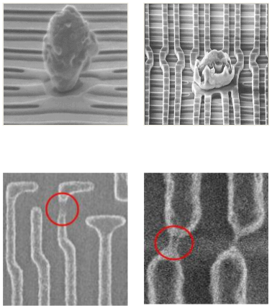
Motivation
Continual scaling enables speed, area, and power improvements
Not without downsides, however
Imperfect fabrication process, showing increasing variation
Early-life and wear-out failures pose new challenges
Need to ensure robustness
3
Notes:
Manufacturing ICs is an imperfect process consisting of hundreds of dependent steps involving some of the most advanced technologies we’ve ever developed. While the continual scaling down of chip features has brought decades of performance and power improvements, the process variation and new defects are making it more and more difficult to produce correct ICs. Specifically, failure modes such as early-life and wear-out failures pose new challenges to testing and accounting for these failures modes. We need to ensure robustness even in the face of these challenges.

Slide 4
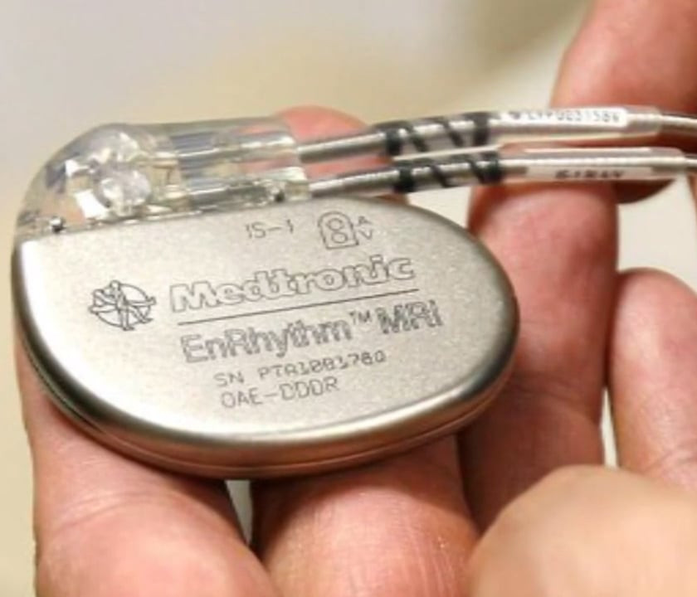

Motivation
Consumer devices easily replaced (but $$$)
Increasing emergence of life- and safety-critical systems; must be robust
Timely replacement is difficult or impossible
4
Notes:
The consequences of an imperfect system vary by application. Consumer devices are typically relatively inexpensive, tolerant of downtime, and easily replaced; The primary consequence of failure is the replacement cost to the manufacturer (if the device is still under warranty) or to the consumer.
However, recent trends like the increasing emergence of life- and safety-critical systems absolutely require robustness. Here, downtime is very problematic, and timely replacement is difficult or impossible. Nobody wants to have to do a firmware update on your pacemaker or self-driving car.

Slide 5
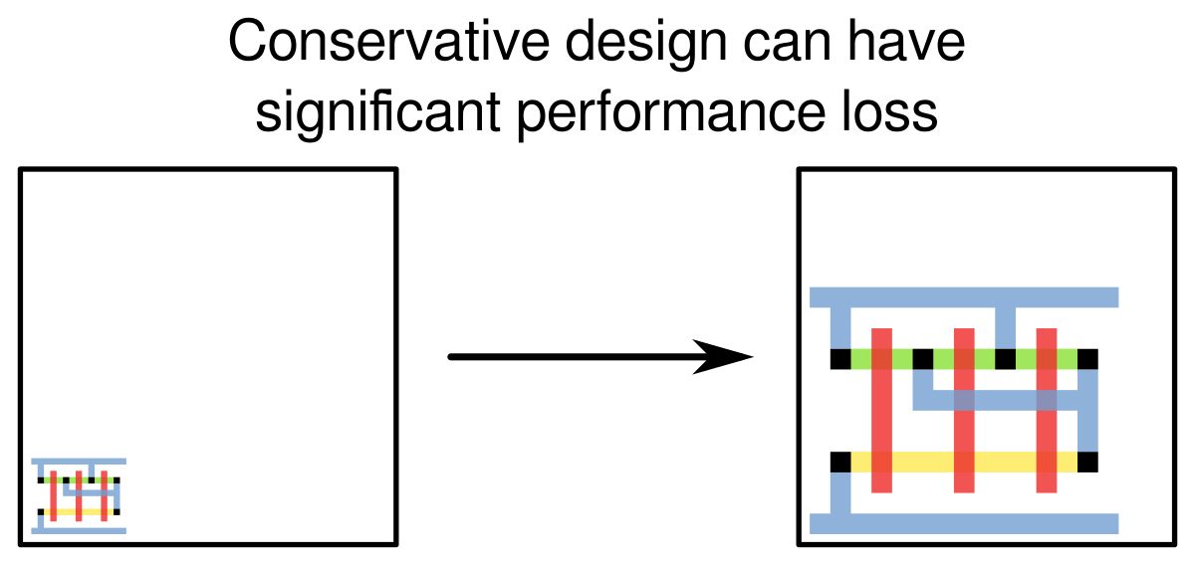
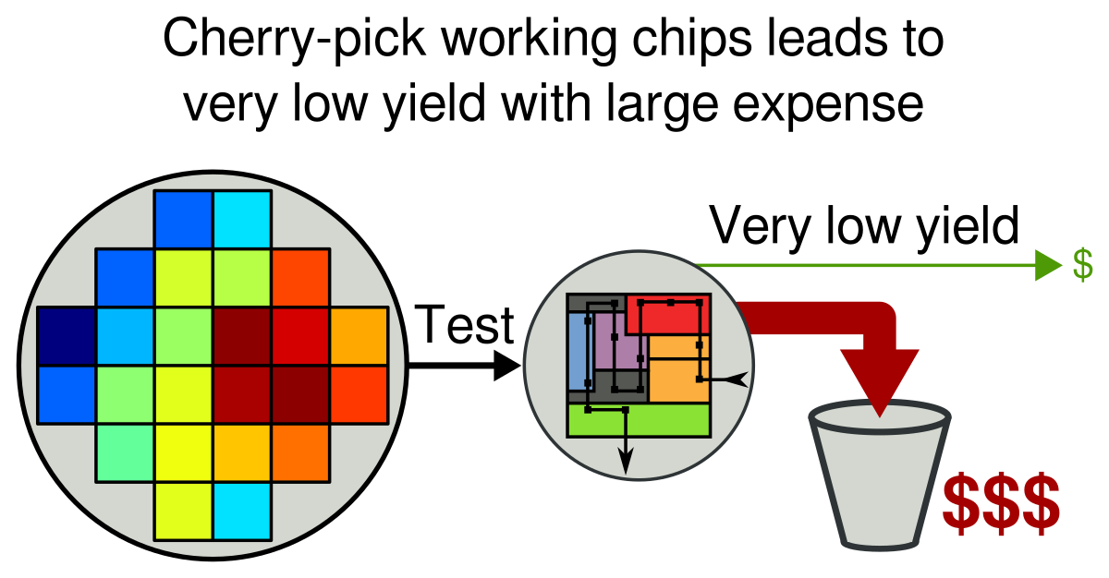
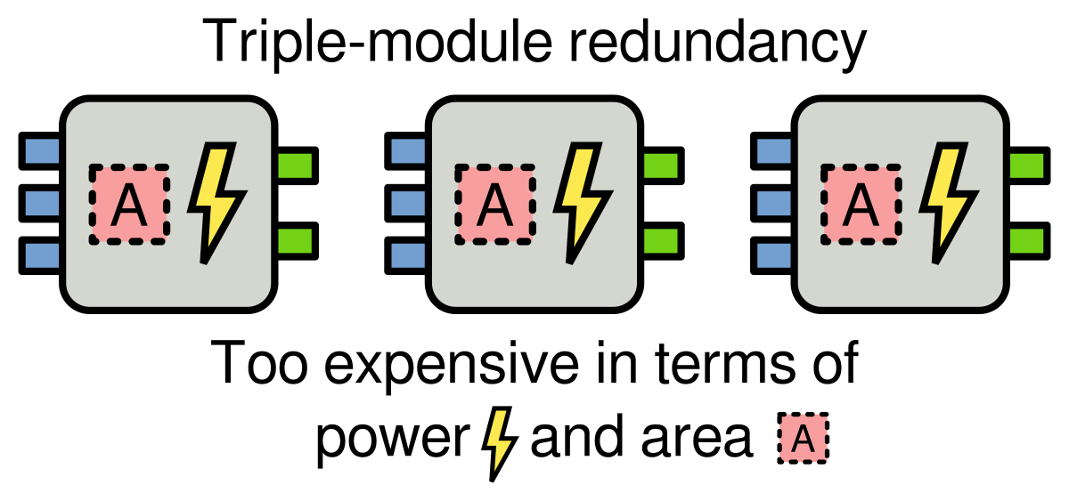
Ensuring Robustness
5
Notes:
Conservative design – Too expensive
Aggressive design + test – Terrible yield
Triple modular redundancy / duplicate with compare – Too much area/power
Other approaches to the problem of robust computing include conservative design techniques that use speed guardbanding, designing for the best-case and using test to cherry-pick devices that actually work, and traditional fault tolerance techniques such as triple-module-redundancy. However all of these techniques are too expensive in terms of area or power consumption, or may not be applicable to both aging as well as early-life failures.

Slide 6
Periodic Test and Diagnosis
Goal: Ensure system robustness by:
Periodic test during runtime (CASP) [Li 08]
Identify the location of any faults
Apply on-chip avoidance/redundancy/repair
Y. Li, S. Makar, and S. Mitra, “CASP: Concurrent Autonomous Chip Self-Test Using Stored Test Patterns,”, IEEE/ACM Design, Automation and Test in Europe, pp. 885-890, 2008.
6
Notes:
This work has the overall goal being to ensure system robustness through on-chip test and diagnosis. The approach consists of three phases. The first phase is to run a periodic self-test of the system throughout its lifetime to find failures or pending failures, based on CASP self-test. The second phase uses the results of the these self-tests to localize the failure within the chip, allowing the system to take an appropriate action in the third phase, such as to repair, replace, or avoid the faulty circuitry.
In this work, we are focusing on the second task, the localization, or diagnosis of any detected or impending failures.

Slide 7
On-Chip Fault Diagnosis
Re-use existing DFT structures to perform high-quality accelerated testing (detect pending failures)
Fault dictionaries can be used for on-chip diagnosis, but do have drawbacks
On-chip diagnosis hardware should have a negligible effect on chip operation (minimal area, time overhead)
7
Notes:
TODO update

Slide 8
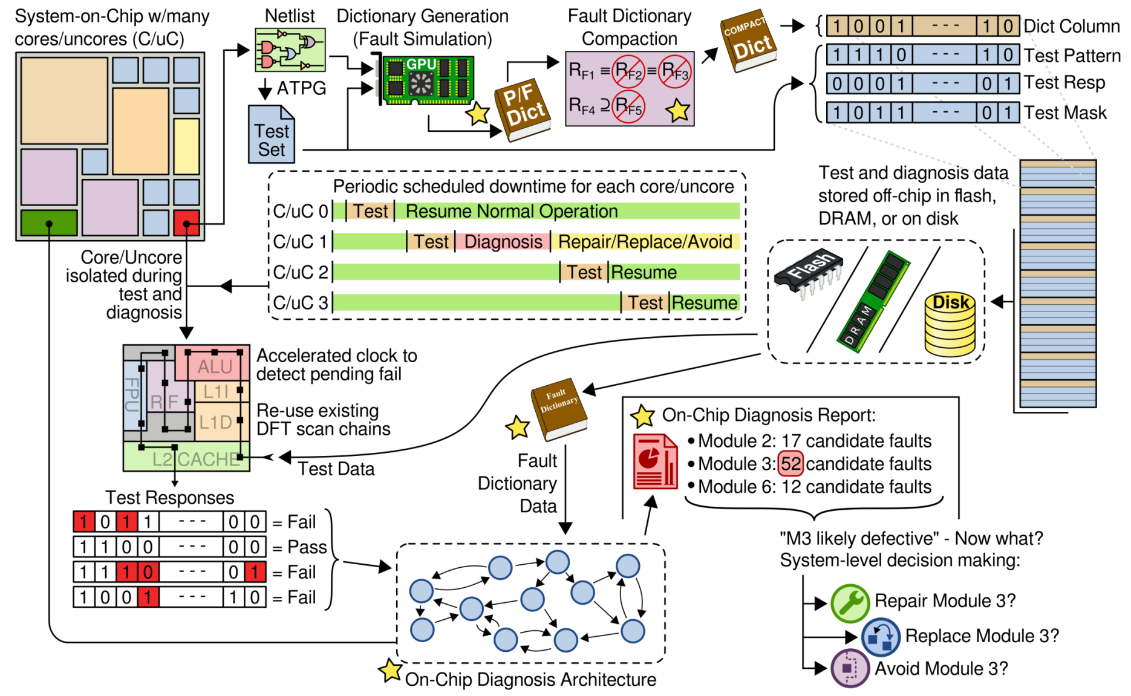
Approach Overview
8
Notes:
This is the top-level view of the overall approach. In the upper-left we have a system on chip with many cores and uncores. In advance, shown along the top, each core or uncore is analyzed and goes through automated test pattern generation. We use those test patterns with the netlist to build and compact a fault dictionary that targets these early-life and wear-out failures. The test and diagnosis data is stored off-chip, in flash, on disk, or in DRAM, until it’s needed for test and diagnosis.
At runtime, the test controller (which isn’t shown here) periodically selects cores and uncores to undergo test. The core or uncore is taken off-line, and test patterns are loaded from off-chip and applied using the existing test hardware such as scan chains, resulting in a series of pass/fail test responses . If any test failures are detected, on-chip diagnosis is used to analyze the failing test responses using the stored fault dictionary data, to determine the most likely location of any failures within the core or uncore. Once diagnosis has been performed, the results are passed to the operating system to enable it to take corrective action, such as to repair, replace, or avoid the affected module.

Slide 9
Outline
Motivation
Transition-X (TRAX) Fault Model
TRAX Fault Model
Fault Simulation Acceleration
Experiments
Hierarchical Fault Dictionary
On-Chip Diagnosis Architecture
Multiple Defect Diagnosis
Conclusions & Future Work
9
Notes:
This brings us to the end of the motivation section and into the first section of new work. In this section, we’ll introduce the new Transition-X fault model (TRAX, for short), discuss how we can accelerate TRAX fault simulation, and present a few experiments to validate both the TRAX model and the fault simulation acceleration.

Slide 10
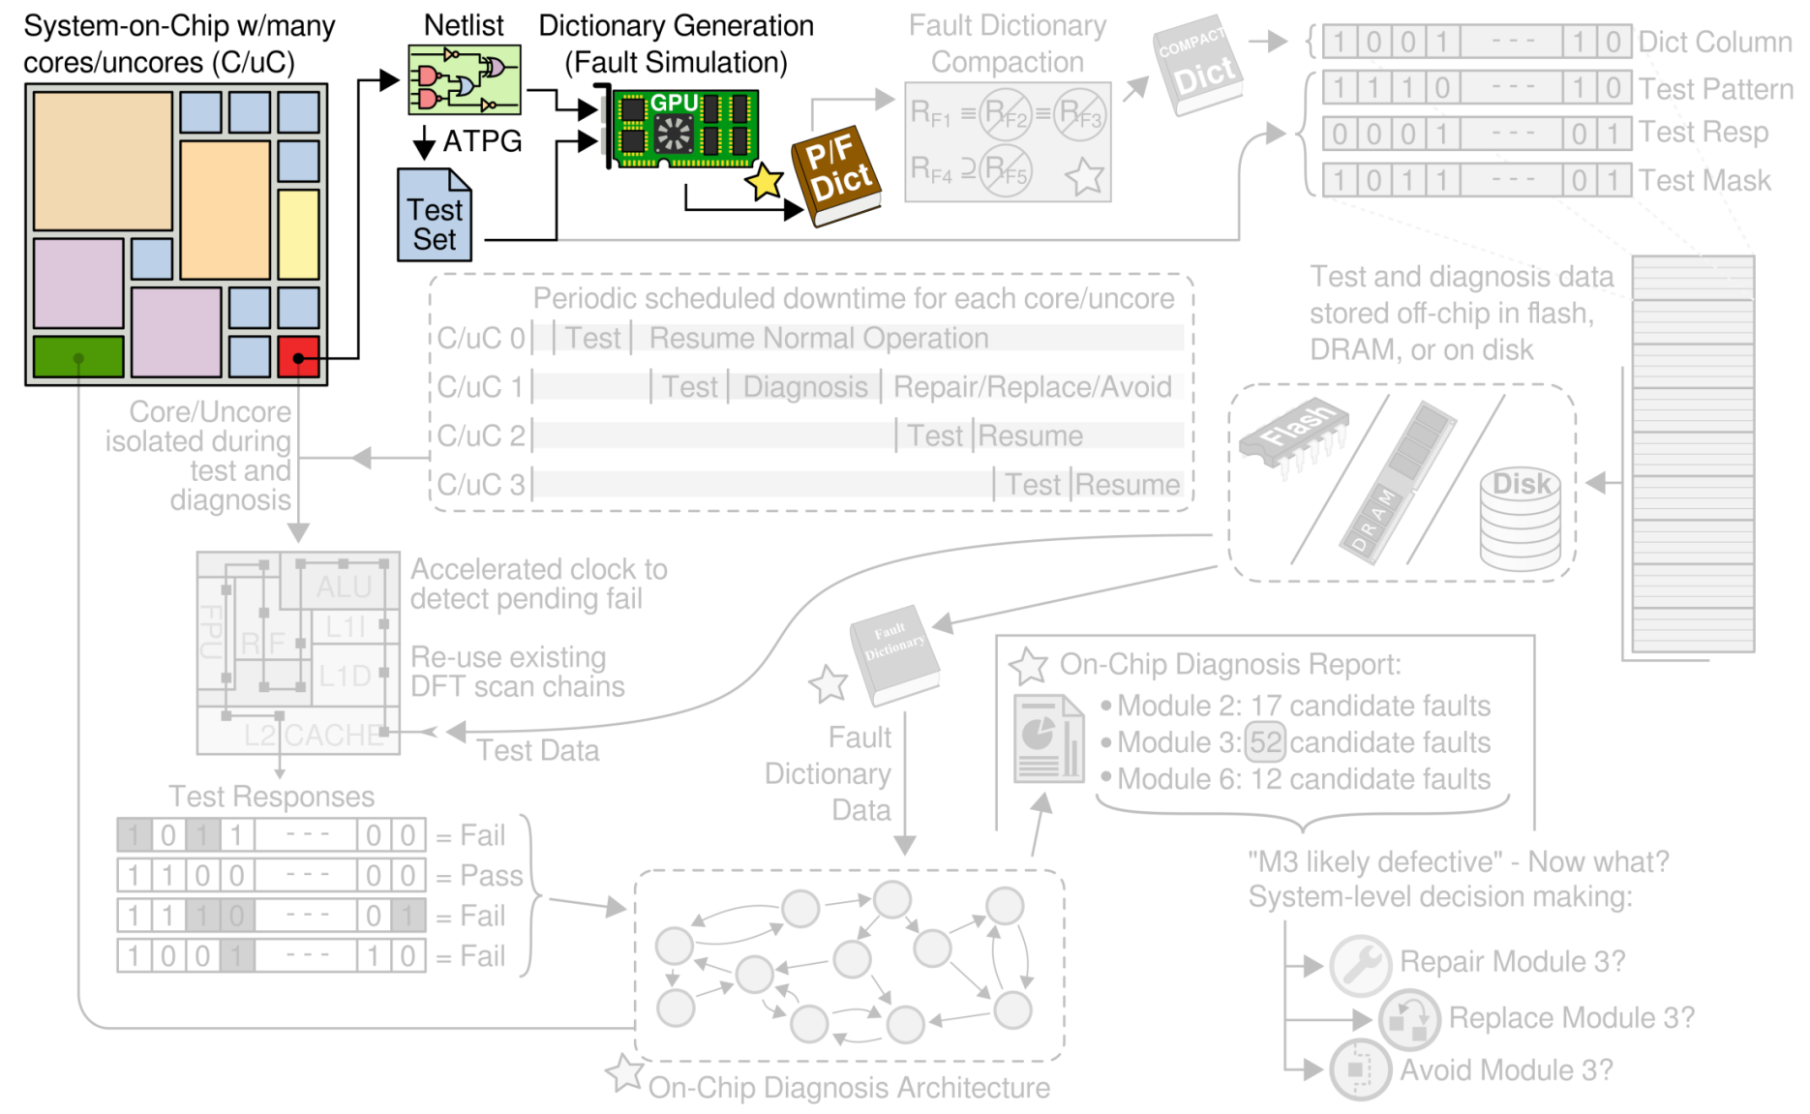
Transition-X (TRAX) Fault Model
10
Notes:
In the context of the overall on-chip test and diagnosis approach to ensuring robustness, this section on the TRAX fault model covers the work done in analyzing each core or uncore of the system on chip to perform fault simulation and build the initial TRAX fault dictionary. The next section will cover the methods used to compact this dictionary to make its size more compatible with the needs and space constraints of on-chip diagnosis.

Slide 11
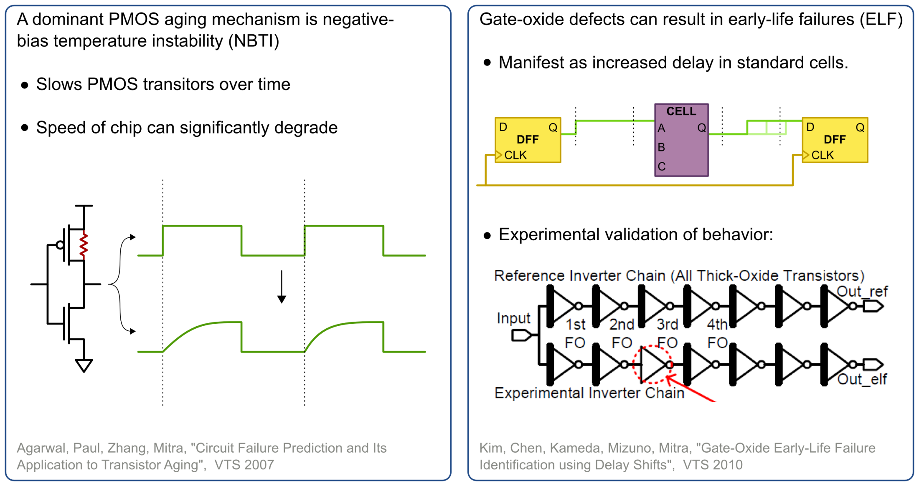
Fault Model for ELF and Aging
Early-life and wear-out failures:
Larger effects with scaling, difficult to test for at t=0
11
Notes:
The first aspect of implementing such a on-chip diagnosis system is to develop a fault model specifically designed to capture the expected misbehavior of the targeted early-life and wear-out failures. As semiconductor fabrications processes continue to scale, aging and early-life failures are more negatively affecting correct system operation, and are posing major reliability challenges to deeply-scaled CMOS. These issues are arising in the field, and wafer or package level test at manufacturing time is insufficient to detect these types of failures.
One example of a dominant transistor aging mechanism is PMOS negative bias temperature instability, or NBTI, causing degraded threshold voltage over time, that results in degraded drive current and increased gate delay.
Early life failures are caused by weak chips that do not fail functional tests at manufacturing time, but may fail earlier in the field, well before the expected product lifetime. Experiments have shown that early-life failures caused by gate oxide defects also manifest as increased delay through standard cells.
The key message here is that aging and early-life failures manifest as increased delay through standard cells, and it is these effects that we are targeting. Given that the delay increases are gradual in nature over the lifetime of the system, circuit failure prediction can be used to detect these failures before they affect correct system operation.

Slide 12
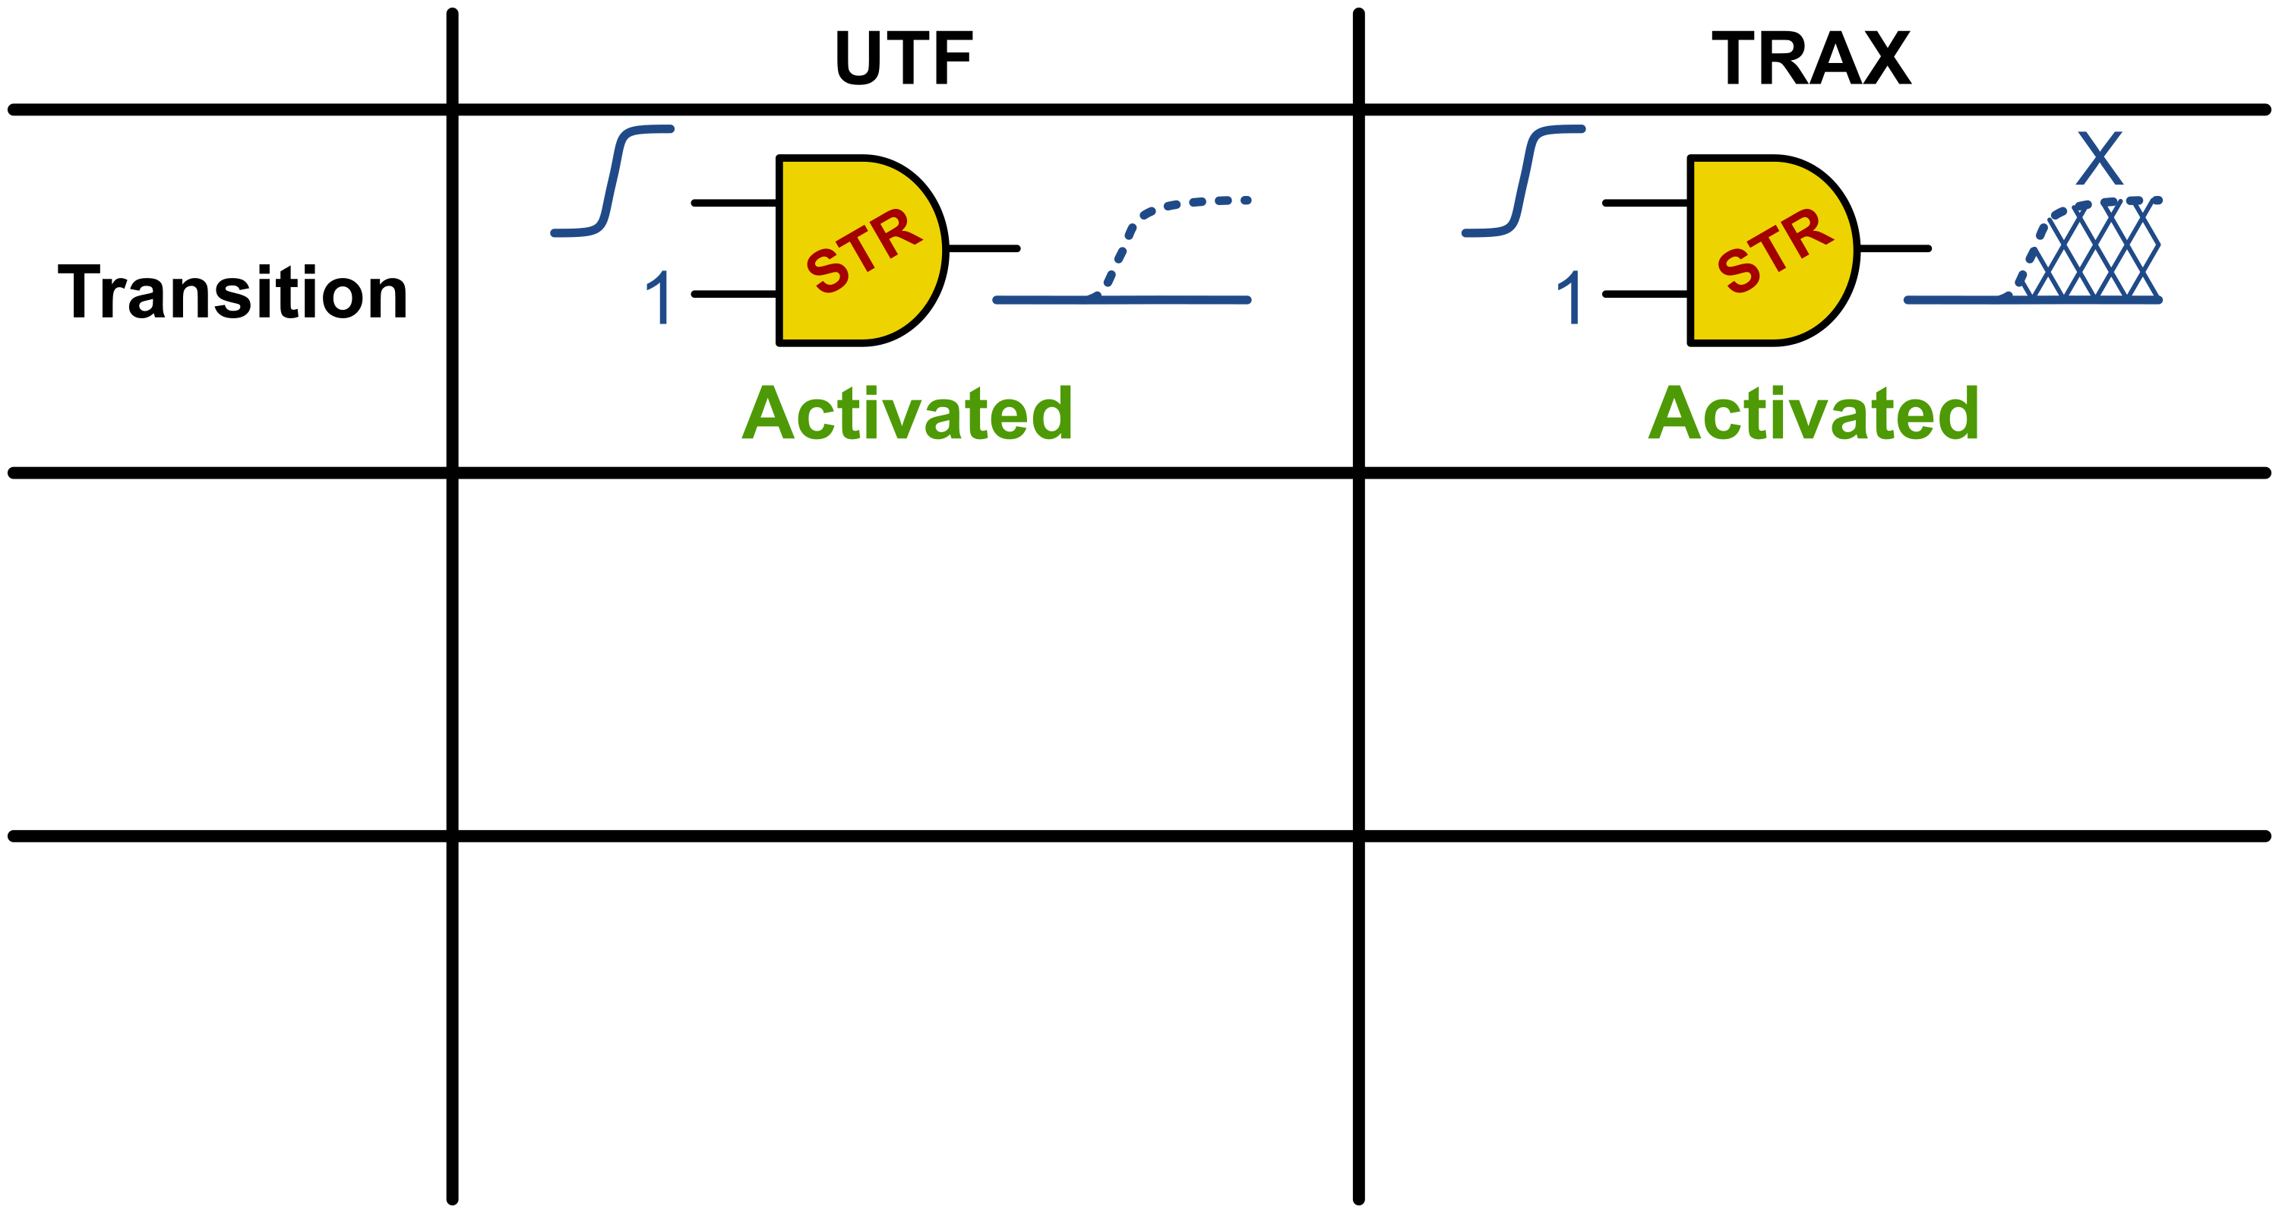
TRAX Fault Model
Activation creates “X” value instead of slowed transition
Activation can be caused by transitions or hazards
12
Notes:
The choice of fault model is important since it will significantly impact the quality of test and diagnosis. The circuit slowdowns due to early life failures and aging are very unpredictable in terms of where the slowdowns will occur, or how large the slowdowns will be. To capture such uncertainty we desire a fault model that is general but also scalable.
We believe the transition-x fault model (TRAX) meets these needs. A TRAX fault is an enhancement of the Unspecified Transition Fault model. Like the unspecified transition fault model, activation results in the unknown X value, but TRAX also supports fault activation by hazards, in order to fully-subsume the potential fault activation conditions.
The use of the x value captures all the possible delay changes that might be caused by early-life or wear-out failures. The activation example here in the first row of the table shows conventional gate-output activation, where both the slow-to-rise unspecified transition fault and TRAX fault are activated by the gate output transitioning from low to high.

Slide 13
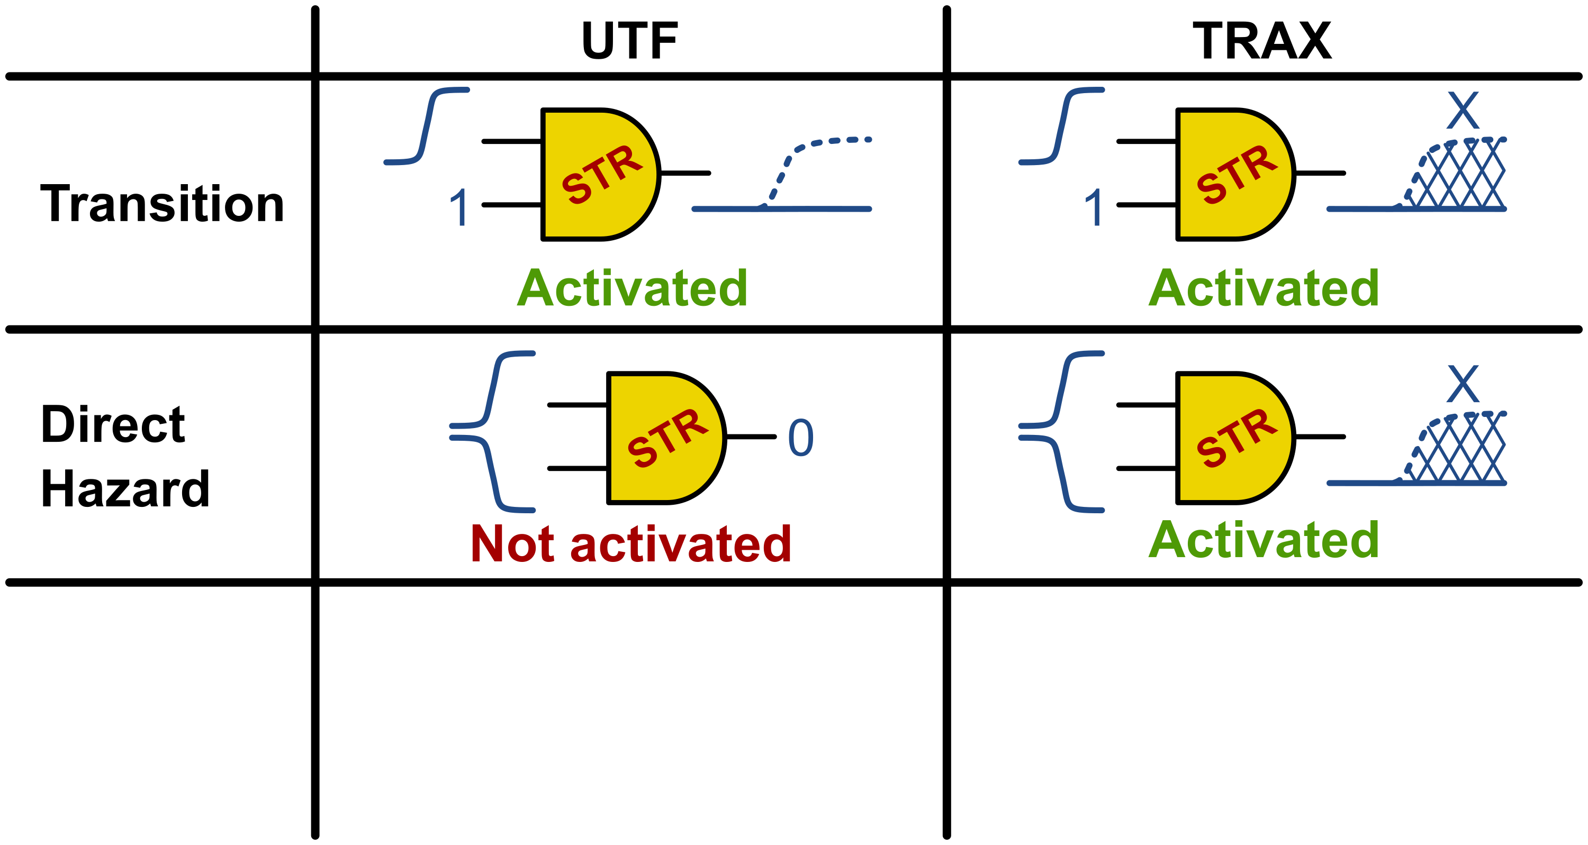
TRAX Fault Model
Activation creates “X” value instead of slowed transition
Activation can be caused by transitions or hazards
13
Notes:
The second row demonstrates what we call “direct hazard activation”, where simultaneously-changing gate inputs have the potential to create an output glitch (this potential to create a glitch is termed a “hazard”). A hazard generated at the output of a gate will activate any TRAX fault located there.

Slide 14
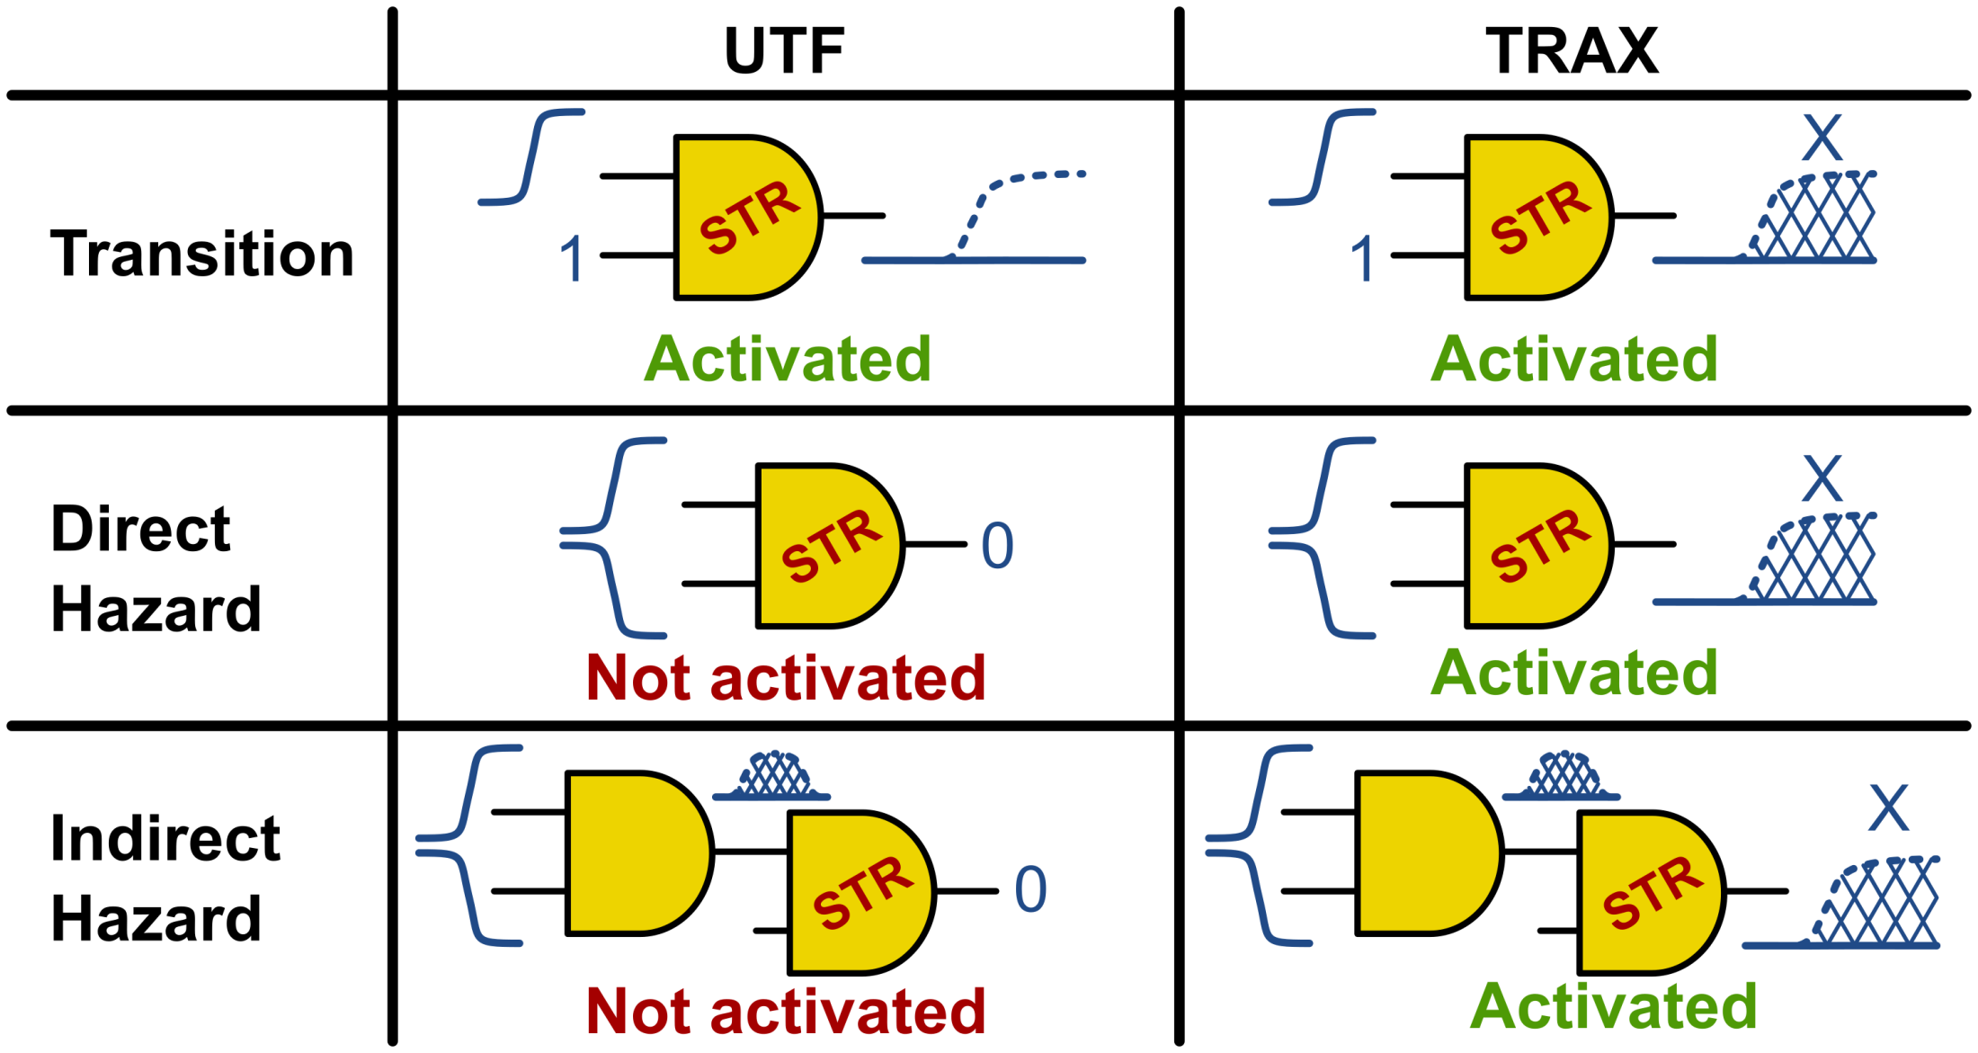
TRAX Fault Model
Activation creates “X” value instead of slowed transition
Activation can be caused by transitions or hazards
14
Notes:
The third row shows a more complex situation where an upstream gate produces a hazard as input to the faulty gate. This also results in a TRAX fault activation, called indirect hazard activation.

Slide 15
Fault Simulation Acceleration
Fault simulation used for test set evaluation
For dictionary generation, no fault dropping is allowed; Must simulate all faults for all tests
Additional TRAX logic values require a full TRAX sim (cannot kickstart with 0/1 sim result)
Graphics Processing Units (GPUs) are used to accelerate massively-parallel problems
Rendering individual pixels of an image
Fault simulating independent test vectors
15
Notes:
Next, I’m going to discuss the acceleration of fault simulation.

Slide 16
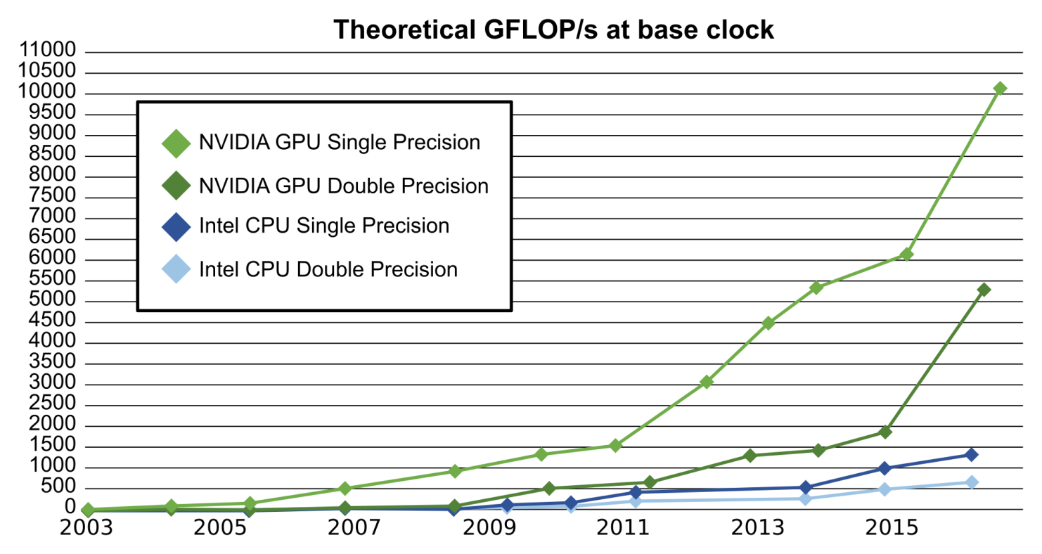
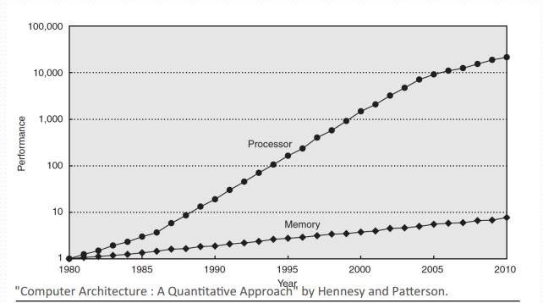
GPU Fault Simulation
[Plot from Nvidia CUDA
C Programming
Guide v8.0.61]
16
Notes:
In the last ten years, the yearly performance gains for single CPU cores have slowed, while multi-core designs have continued to see huge gains in peak computational performance. This of course only results in actual performance gain if the problem at hand contains enough parallelizable sections to take advantage of all these parallel cores. Fortunately, fault simulation is one such problem. The plot in the upper-left shows theoretical peak gigaflops per second for the fastest single-core CPUs and fastest GPUs from the past fifteen years.
Additionally, as shown in the lower-right plot, the relative performance gains of processors are greatly-outstripping the relative performance gains of memory. This leads to frequent memory starvation and IO-bound computation. Fortunately, this problem can be partially alleviated when GPU programming by frequently swapping in and out blocks of GPU threads to ensure that any threads waiting on IO are rescheduled for later once that memory is available. This ensure that the GPU cores are nearly always performing active computation.

Slide 17
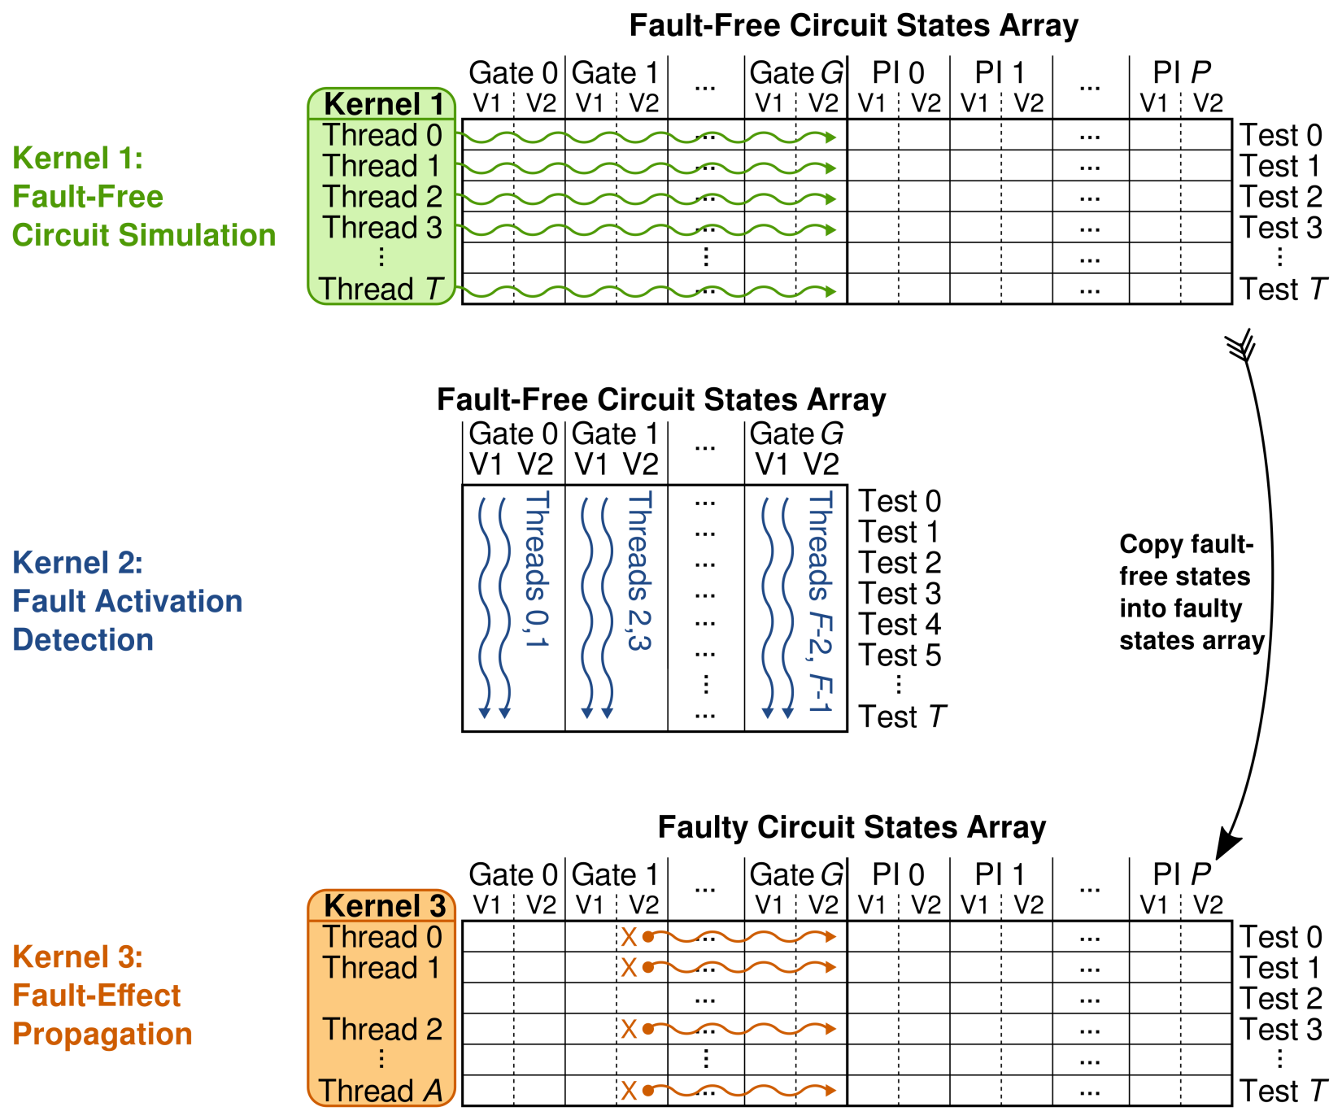
GPU Kernel Implementation
17
Notes:
The GPU Fault simulation process is divided into three phases, with a corresponding GPU kernel for each phase. In the hybrid CPU/GPU system employed by the Nvidia CUDA architecture, the top-level main program runs on the CPU, which manages memory on the CPU and GPU, and also triggers the execution of GPU kernels, which are the widely-parallel functions designed to run on the GPU itself.
The overall approach is to first do a fault- free circuit simulation to determine the fault-free values of a signals in the circuit, for each test. This build up the fault-free circuit stats array shown here at the top. Kernel 1 uses one GPU thread for each test, and each thread performs a complete circuit simulation of all gates in the presence of the specific test. This one-pass gate evaluation approach takes advantages of the fact that the gates of the combinational or full-scan circuit have been topologically sorted, where each gate’s input values have been already computed by the time the thread evaluates that gate. This simplifies the kernel code and ensure that each GPU thread stays in lock-step, improving performance.
Once the fault-free circuit states have been computed, we need to determine which faults are activated in which tests. Kernel 2 allocates two GPU threads per gate (one each for the STF and STR faults), and each thread analyzes the inputs for one gate. Kernel 2 is analyzing the fault-free circuit states array from Kernel 1 to determine which tests cause fault activation.
The activation data is collected and used to guide Kernel 3, which is used to activation each fault and simulate the affected gates and their fan-out, to determine if the fault effects reach any circuit outputs. Kernel 3 is invoked once per fault, and allocates one GPU thread for each activation of that fault. Each GPU thread injects the TRAX X value at the fault site and then proceeds to simulate the gates that follow topologically-ordered list. For fault sites later in the topological ordering, the kernel effectively skips re-evaluating all the earlier gates, increasing performance. As the threads are re-evaluating the gates, if any evaluated gate produces an X value and also drives a circuit output, the fault is marked as detected by setting the bit in the corresponding row and column of the fault dictionary data structure, which is the final output of this process.

Slide 18
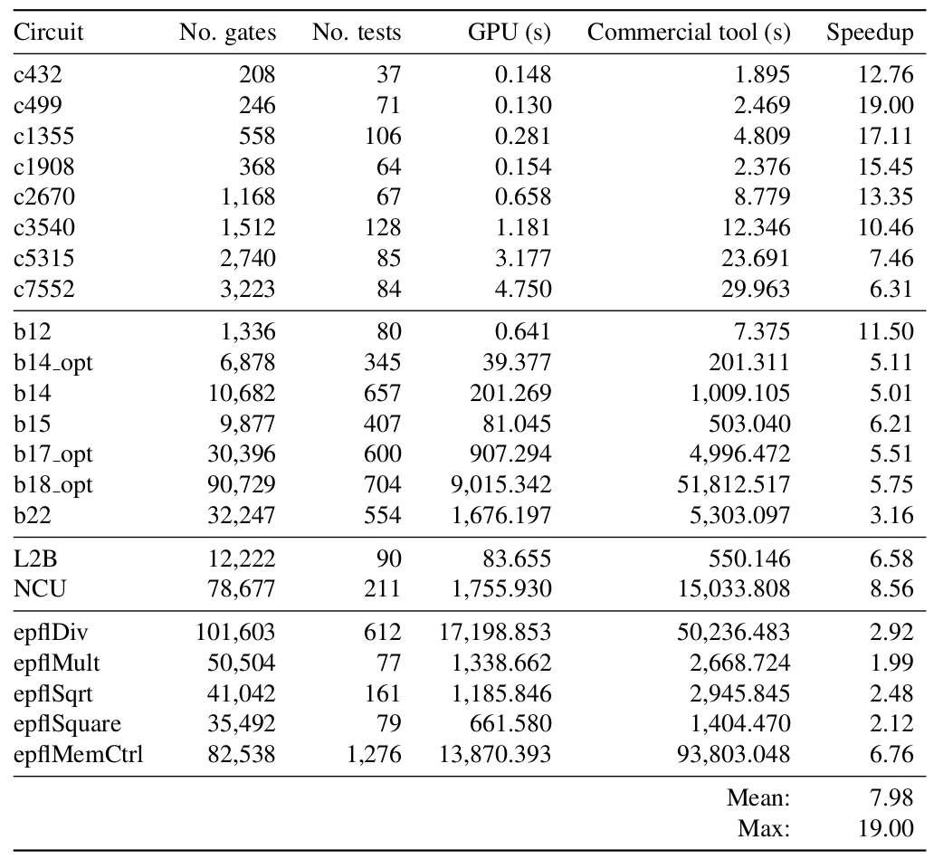
Fault Simulation Acceleration
18
Notes:
We compare the execution time of the GPU fault simulator against the runtime of a commercial fault simulation tool. We used ATPG test patterns from the same tool, and simulated the same circuit for the same faults with the same test set in both the GPU simulator and the commercial fault simulation tool. Comparative results are shown here. We see that the GPU is always faster to perform the fault simulation than the commercial tool, showing a speed-up of nearly 8x on average, with a maximum speed-up of 19x.

Slide 19
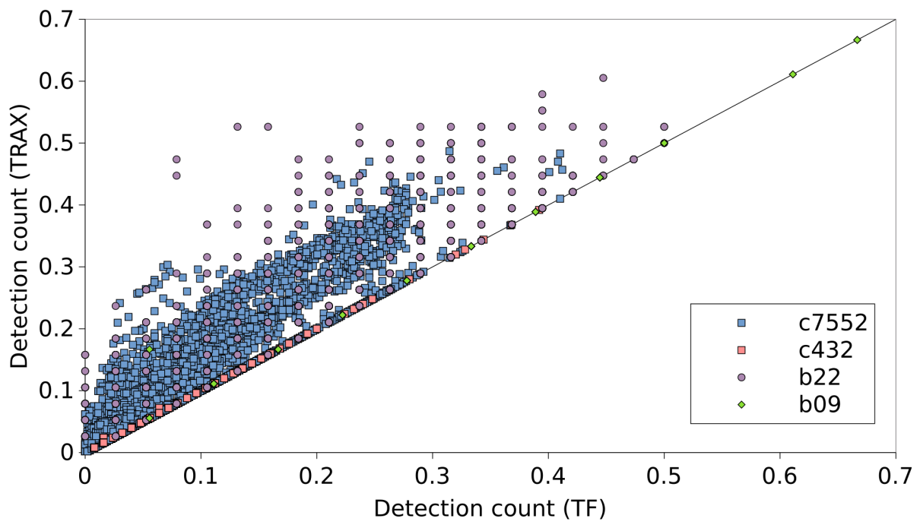
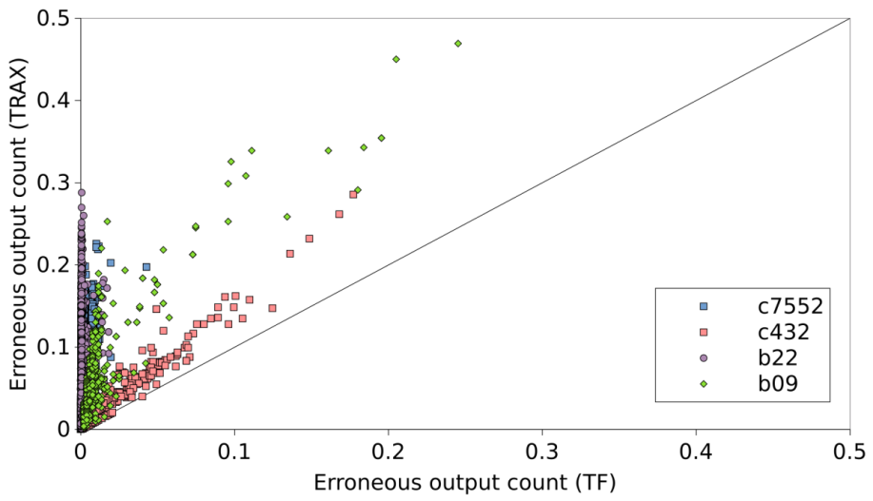
TRAX – TF Comparison
Fault simulation
Each point is a single TRAX/TF fault site
Position is determined by normalized counts
Failing test (top) Failing outputs (bottom)
Data gathered by Harsh Shrivastava
19
Notes:
As a way of validating the TRAX fault model to confirm that it is behaving properly, a series of fault simulation experiments were performed a few years ago with help from our ACTL summer intern Harsh. We simulated thousands of TRAX and transition faults for a few different circuits. For each fault we recorded the count of erroneous circuit outputs, as well as the detection count (that is, the number of tests that detected the fault), and used those counts to plot points in each of these two charts. The top chart is the detect count and the bottom chart is the erroneous output count. Each point represents a single fault site and polarity, either STR or STF, and is positioned in x and y based on the normalized count for TRAX (vertical axis) and TF (horizontal axis). WE see that all of the points are plotted above the 45 degree line, indicating that for every fault site, the TRAX fault produces more potentially-erroneous outputs and is detected by more tests than the co-located transition fault. This was a good early validation that the TRAX fault model was correctly subsuming the behavior of transition faults.

Slide 20
TRAX Summary
TRAX fault model targets the delay slowdowns of early-life and wear-out failures
Fault simulation experiments show 8x speed-up for GPU-accelerated fault simulator
Fault simulation shows TRAX subsumes TF faulty output and detection counts
20

Slide 21
Outline
Motivation
Transition-X (TRAX) Fault Model
Hierarchical Fault Dictionary
On-Chip Diagnosis Requirements
Fault Equivalence and Subsumption
Dictionary Size Reduction
On-Chip Diagnosis Architecture
Multiple Defect Diagnosis
Conclusions & Future Work
21
Notes:
TODO

Slide 22
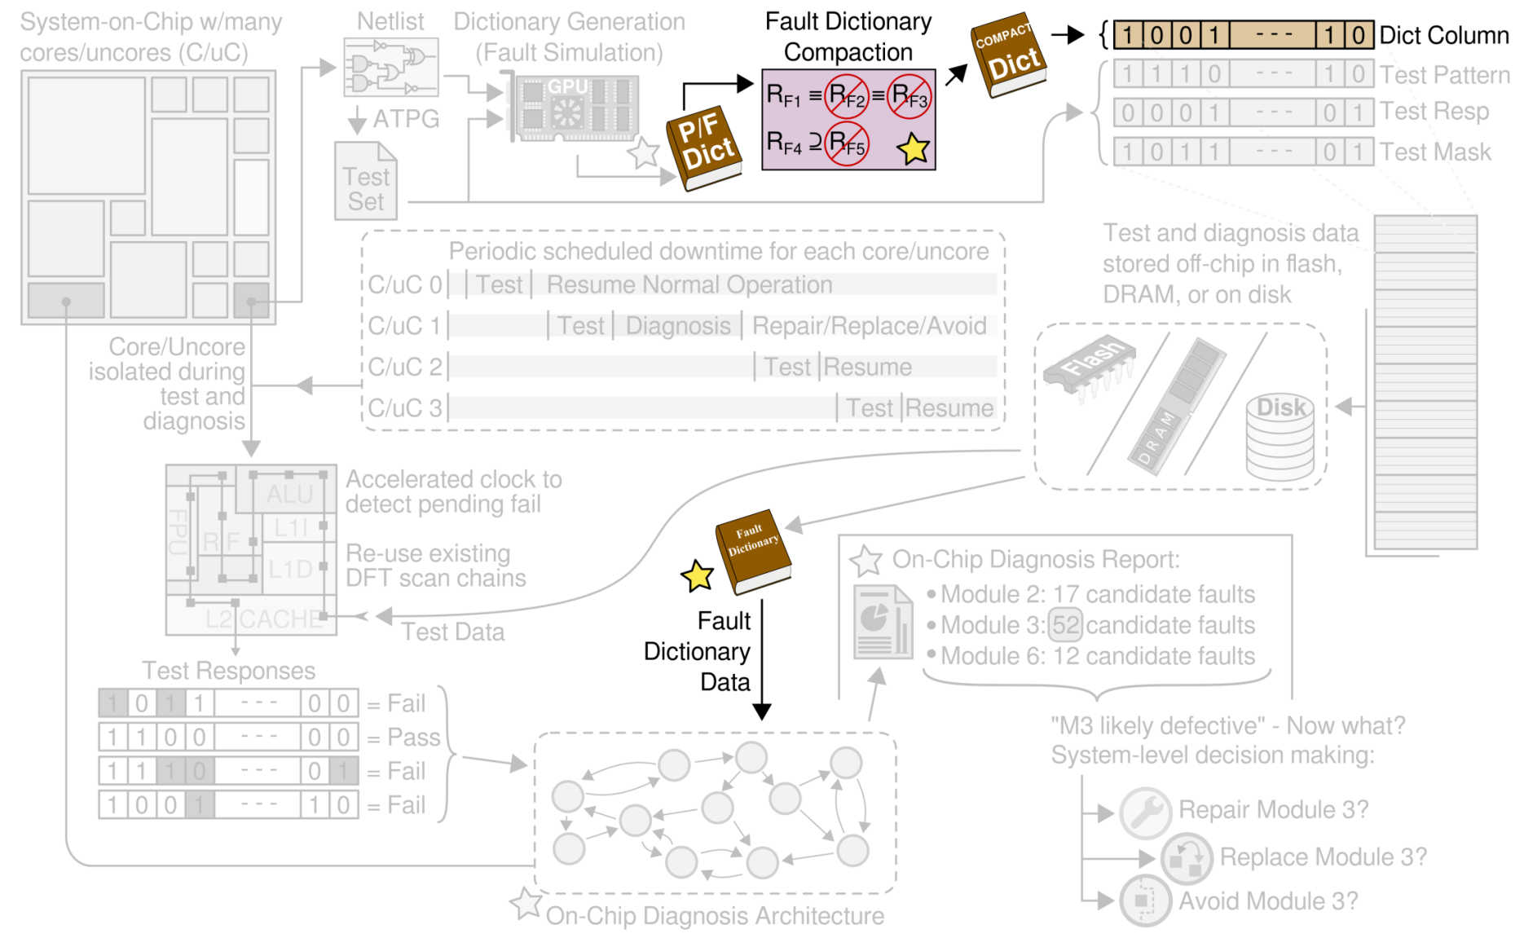
Hierarchical Fault Dictionary
22
Notes:
In the context of our on-chip test and diagnosis process, the fault dictionary is a pre-computed table of expected circuit behavior in the presence of each modeled fault. The fault dictionary is generated using the GPU-accelerated fault simulator, and it undergoes a compaction process to reduce the size.
Once the tests have been applied to the core or uncore under test, the fault dictionary is used by the diagnosis process to localize the detected failure.
One important aspect of using a fault dictionary for on-chip diagnosis is the overall size of the dictionary’s data. For example, the L2B uncore from the OpenSPARC T2 processor requires over 600 MB of storage for the full-response dictionary, which is impractical for such a relatively small circuit. Fortunately, we can take advantage of the unique situation of on-chip diagnosis to significantly reduce the size of a fault dictionary. Additionally, since the test and diagnosis data is stored off-chip, reducing the dictionary size results in a few benefits, including that
less off-chip storage is required, it takes less time to load –up the dictionary for on-chip use, and we require less time for performing on-chip diagnosis.

Slide 23
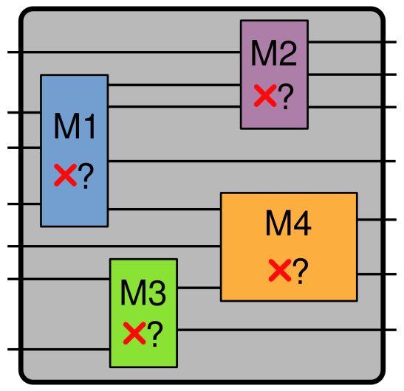
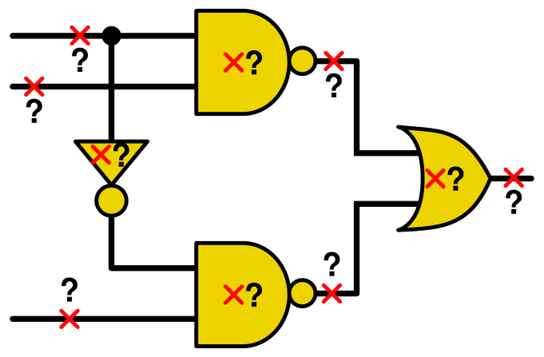
Diagnosis Requirements
Conventional diagnosis
Identify faulty gate/signal
Fine-grained
Physical failure analysis
Process improvement
Module-level diagnosis
Identify defective module
Coarse-grained
Repair, replace, or avoid
Suitable for on-line use
23
Notes:
The goals of on-chip diagnosis differ significantly from the goals of conventional fault diagnosis. In conventional fault diagnosis, the focus is on fabrication process or low-level design improvement, typically by using physical failure analysis (PFA) on the diagnosis sites reported. This requires a precise result, ideally the actual (x, y, z) coordinates of the failure.
In contrast, the requirements for module-level diagnosis are comparatively relaxed, due to the fact that if a module is found to be defective, some action must be taken, such as repair, replacement, or avoidance. These actions are only available for larger modules of the design hierarchy. For example, it’s not possible to repair a single transistor, or replace a single flip-flop. This relaxes the required diagnosis precision for on-chip diagnosis, and enables significant dictionary compaction.

Slide 24
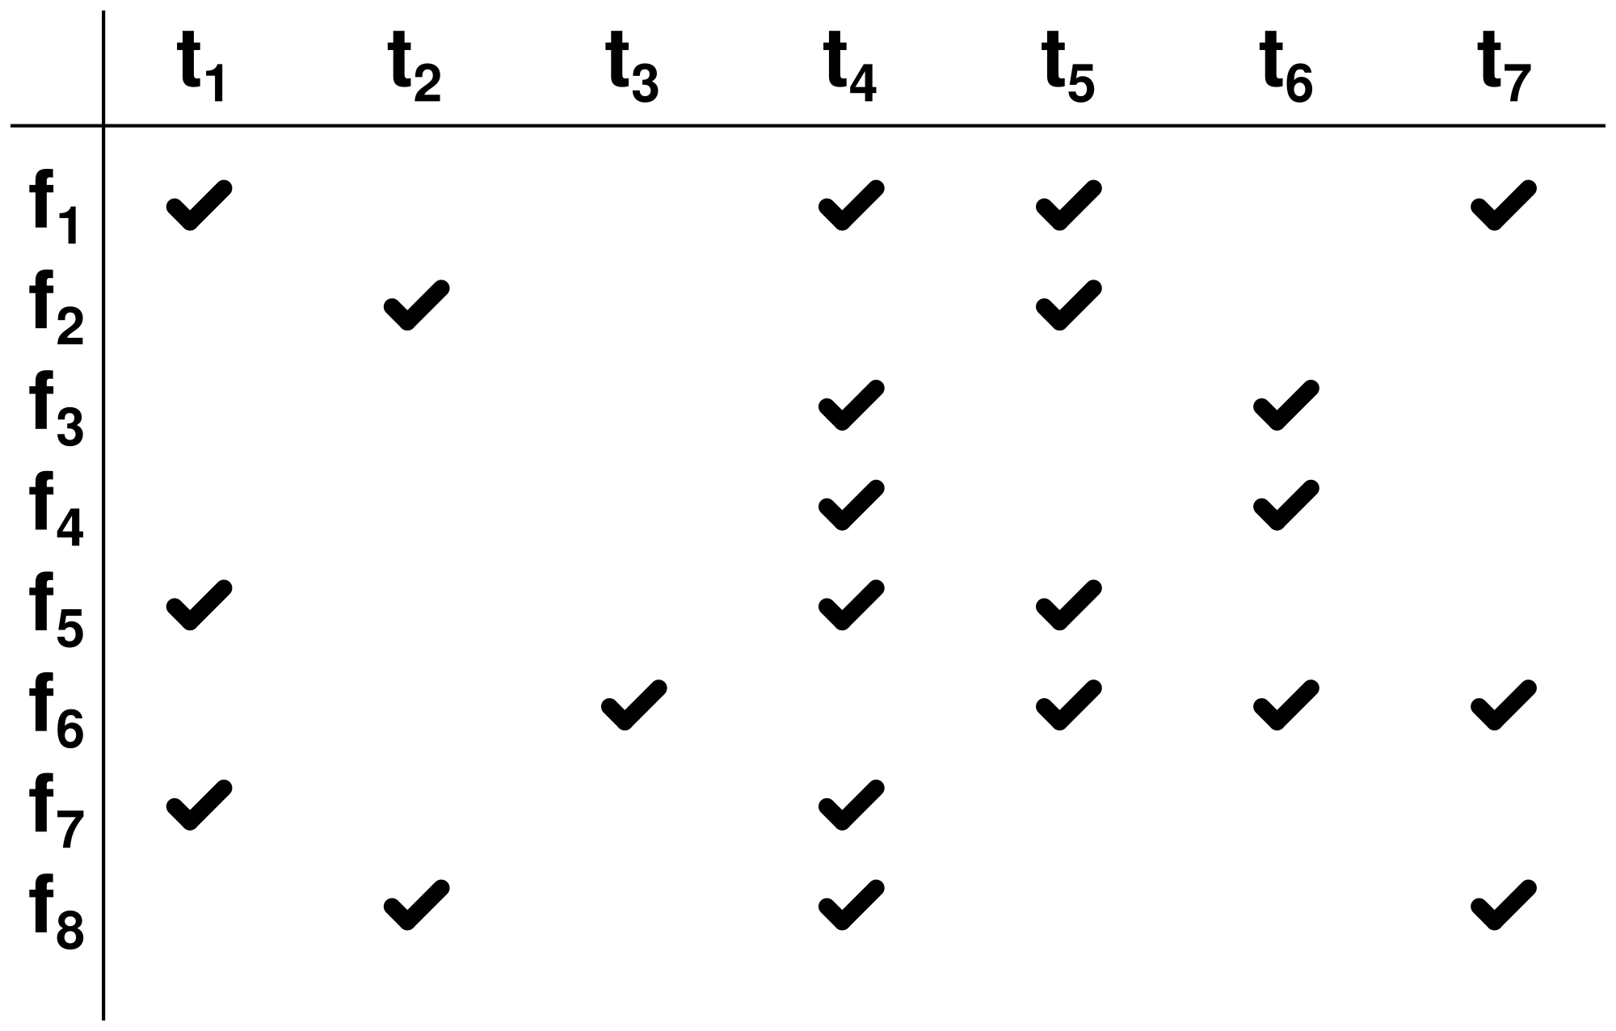
Fault Dictionary Construction
24
Notes:
To start with, a fault dictionary can be viewed as a table of expected circuit responses (or some subset) for each modeled fault, for each test in the test set.
Here, each row of this dictionary describes the behavior of a specific fault when several tests are applied. Each column of the dictionary describes the set of faults that are detected by that test. Since the dictionary only includes a single bit for each fault/test pair, indicating if the test can detect the fault, this type of dictionary is called a pass/fail dictionary.

Slide 25
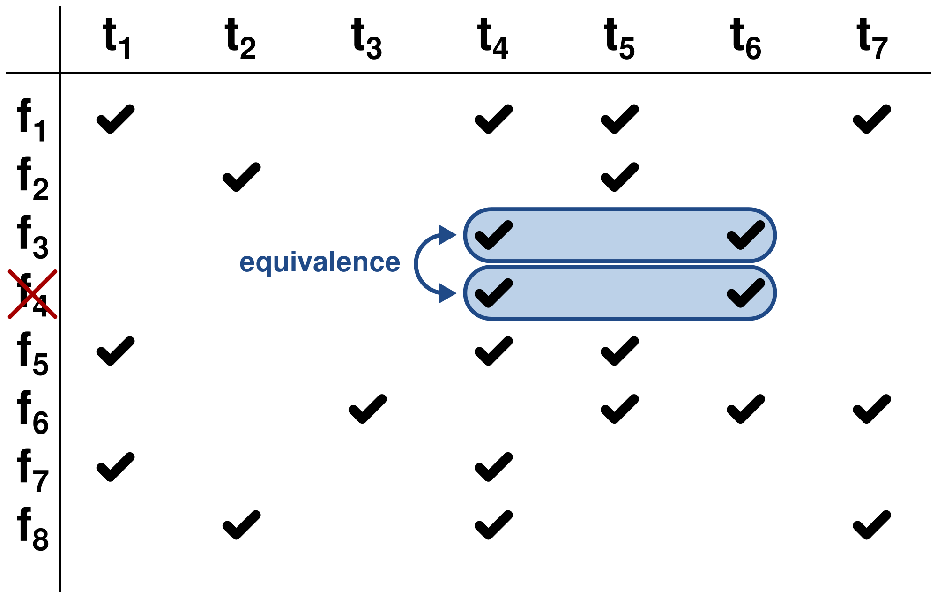
Fault Equivalence
25
Notes:
Requiring diagnosis only to the level of repair means that the fault dictionary does not need to distinguish faults belonging to the same repair-level module.
For intra-module faults that are test-set equivalent, like F3 and F4 shown here in blue, all-but-one of the equivalent faults can be eliminated, as we don’t need to distinguish them.

Slide 26
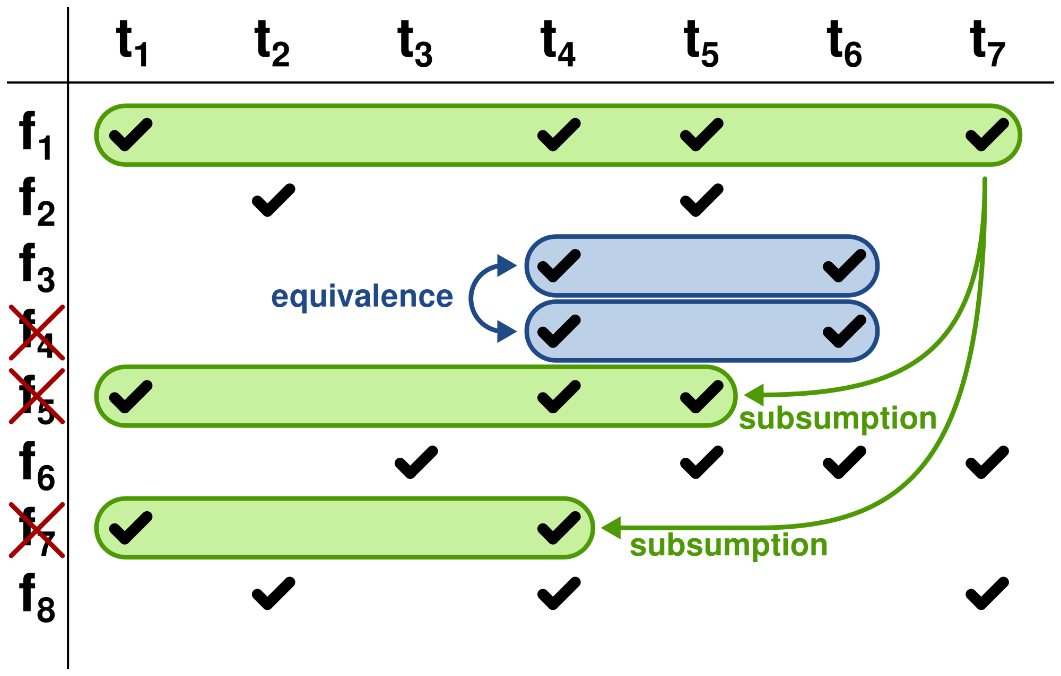
Fault Subsumption
26
Notes:
Additionally, for intra-module faults where the response of one fault subsumes the response of other faults, the subsumed faults can be eliminated.
For example faults 5 and 7 here in green are both subsumed by fault 1 and eliminated.
Eliminating faults by equivalence and subsumption results in a collapsed pass/fail fault dictionary.
For the L2B example from before, the 600 MB full-response dictionary is reduced to less than 32 KB here in the collapsed pass/fail dictionary.

Slide 27
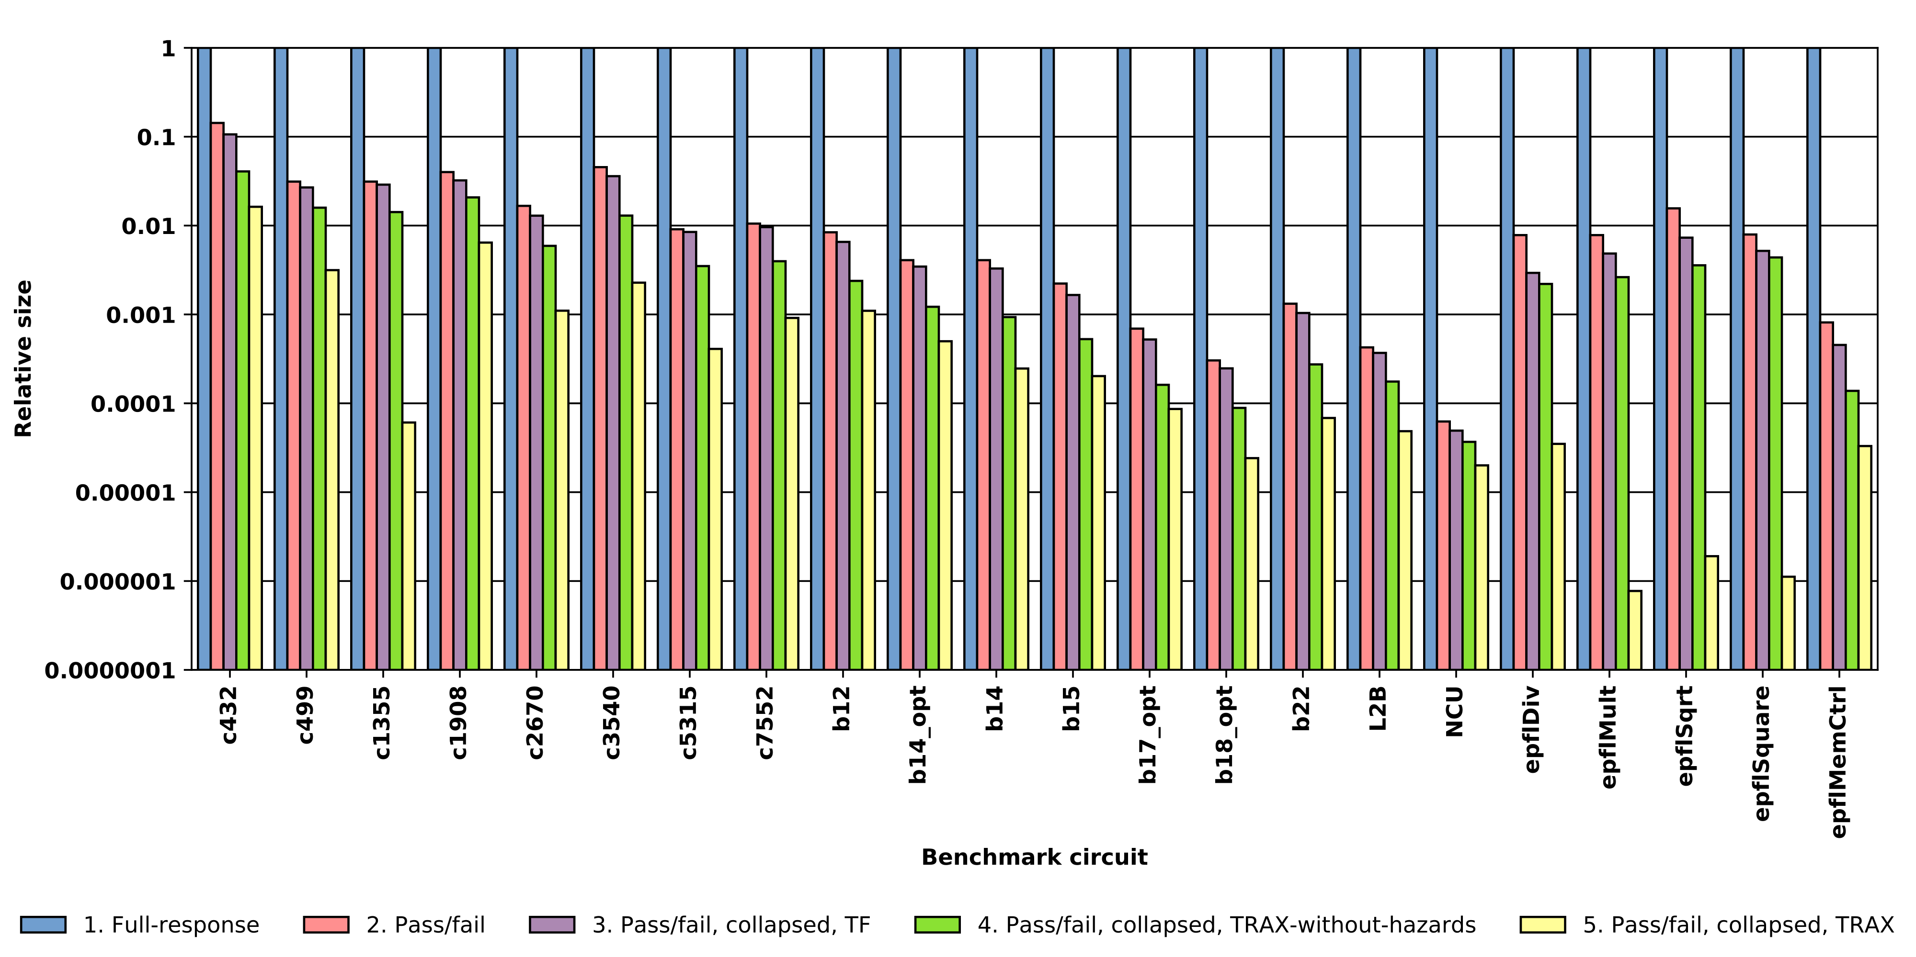
Dictionary Size Reduction
Average reduction: 98.64% (TF), 99.37% (TRAX-without-hazards), 99.85% (TRAX)
27
Notes:
Measuring dictionary compaction due to fault elimination requires access to designs with multiple levels of hierarchy. The ISCAS85 circuits are pre-partitioned into functional modules.
The remaining circuits, which are from the ITC99 and EPFL benchmarks and OpenSPARC T2 processor design, and are partitioned into modules using graph clustering algorithms.
This plot shows the dictionary size reduction for 22 analyzed circuits.
Each circuit has five bars, normalized to the size of the full-response dictionary.
First is full-response
Second bar shows the compaction resulting from pass/fail compaction
Third bar shows the transition fault dictionary, which can only be compacted using fault equivalence, and not fault subsumption
Fourth and fifth bars show the compaction achieved with the TRAX fault elimination. The fourth bar is a variant on TRAX called TRAX-without-hazards.

Slide 28
Dictionary Summary
Failure localization needed only to the level of repair, replacement, or avoidance
The hierarchical fault dictionary eliminates inter-module faults using equivalence and subsumption relationships
Dictionary compaction experiments show average size reduction of 99.85% (TRAX)
28
Notes:
In the context of on-chip diagnosis, Failure localization needed only to the level of repair, replacement, or avoidance
The limited options for runtime recovery permit relaxed diagnostic requirements, enabling the use of fault equivalence and subsumption to remove faults from the dictionary and reduce the size of the fault dictionary.
Dictionary construction and compaction experiments have shown dictionary size reduction by over 99.85% for the TRAX dictionary.

Slide 29
Outline
Motivation
Transition-X (TRAX) Fault Model
Hierarchical Fault Dictionary
On-Chip Diagnosis Architecture
TRAX On-Chip Hardware
Diagnosis Hardware Overhead
Experiments
Multiple Defect Diagnosis
Conclusions & Future Work
29
Notes:
TODO

Slide 30
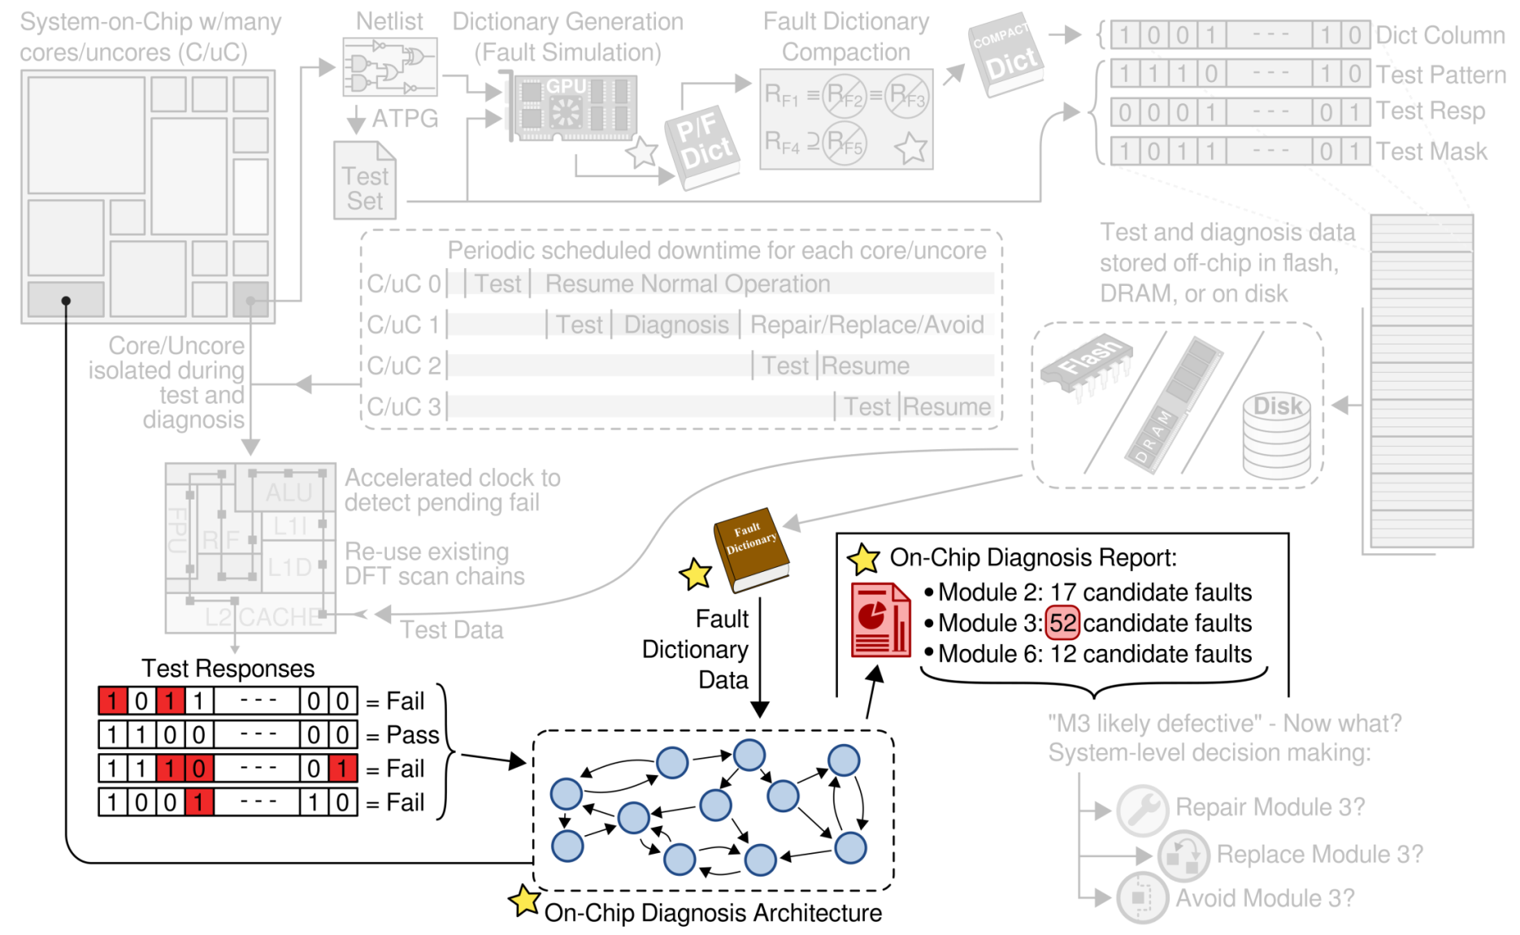
On-Chip Diagnosis Architecture
30
Notes:
In the context of the on-chip test and diagnosis process, diagnosis is only performed if any of the recorded test responses indicate a failing test. The responses are used with the fault dictionary data to determine the most-likely defective module. The on-chip diagnosis process is performed by a new Diagnosis Architecture, producing a diagnosis report that calls-out the most likely defective module.

Slide 31
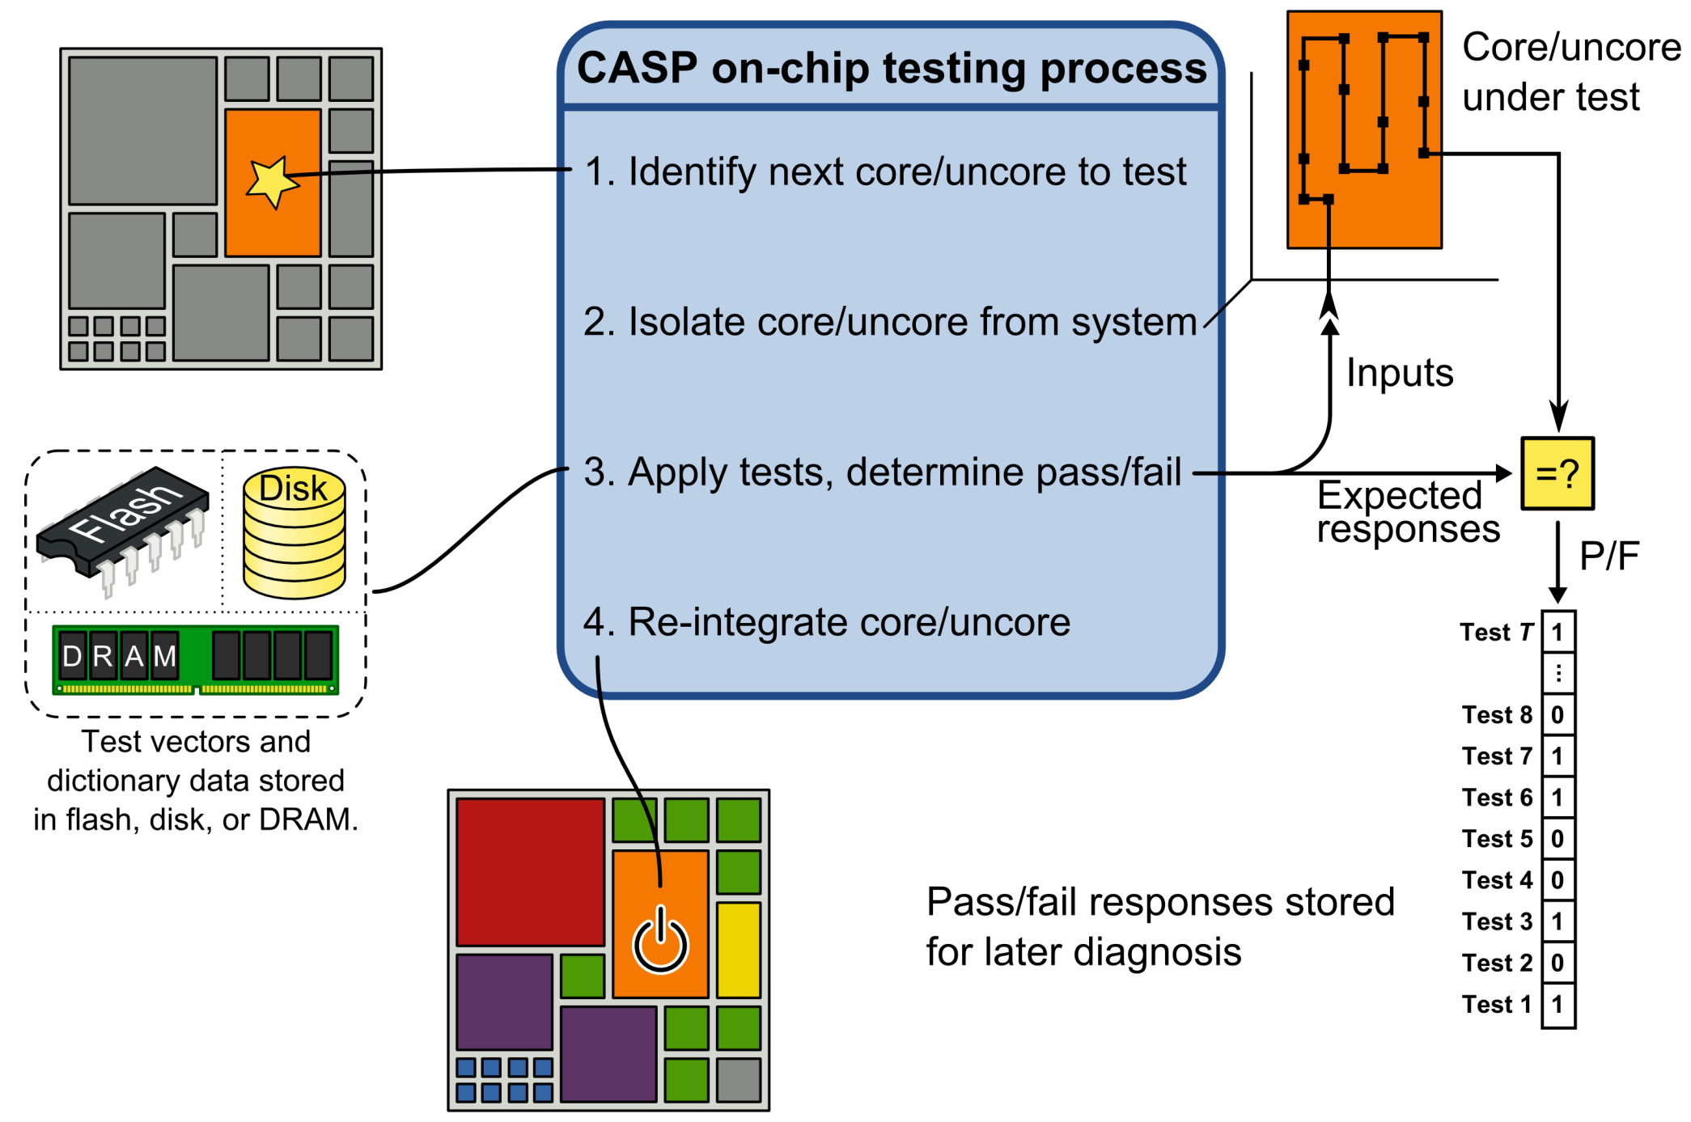
Y. Li, S. Makar, and S. Mitra, “CASP: Concurrent Autonomous Chip Self-Test Using Stored Test Patterns,”, IEEE/ACM Design, Automation and Test in Europe, pp. 885-890, 2008.
31
Notes:
Before we present the details of the on-chip diagnosis architecure, I first want to introduce the details of the CASP on-chip testing process, to provide further background and context to the system here.
In the first phase of CASP, a core or uncore is selected for test. Second, the selected core is isolated from the system, and prepared for testing. The third phase performs the actual test by loading and applying each test to the selected core or uncore, analyzing each response for failures. Finally, the core or uncore is re-integrated with the system to resume execution. This on-chip test process was not created as part of our work here, but is used as a stepping-off point for the on-chip diagnosis we will present next.
The results of each test are stored for later analysis as a single pass/fail bit in a register as shown.

Slide 32
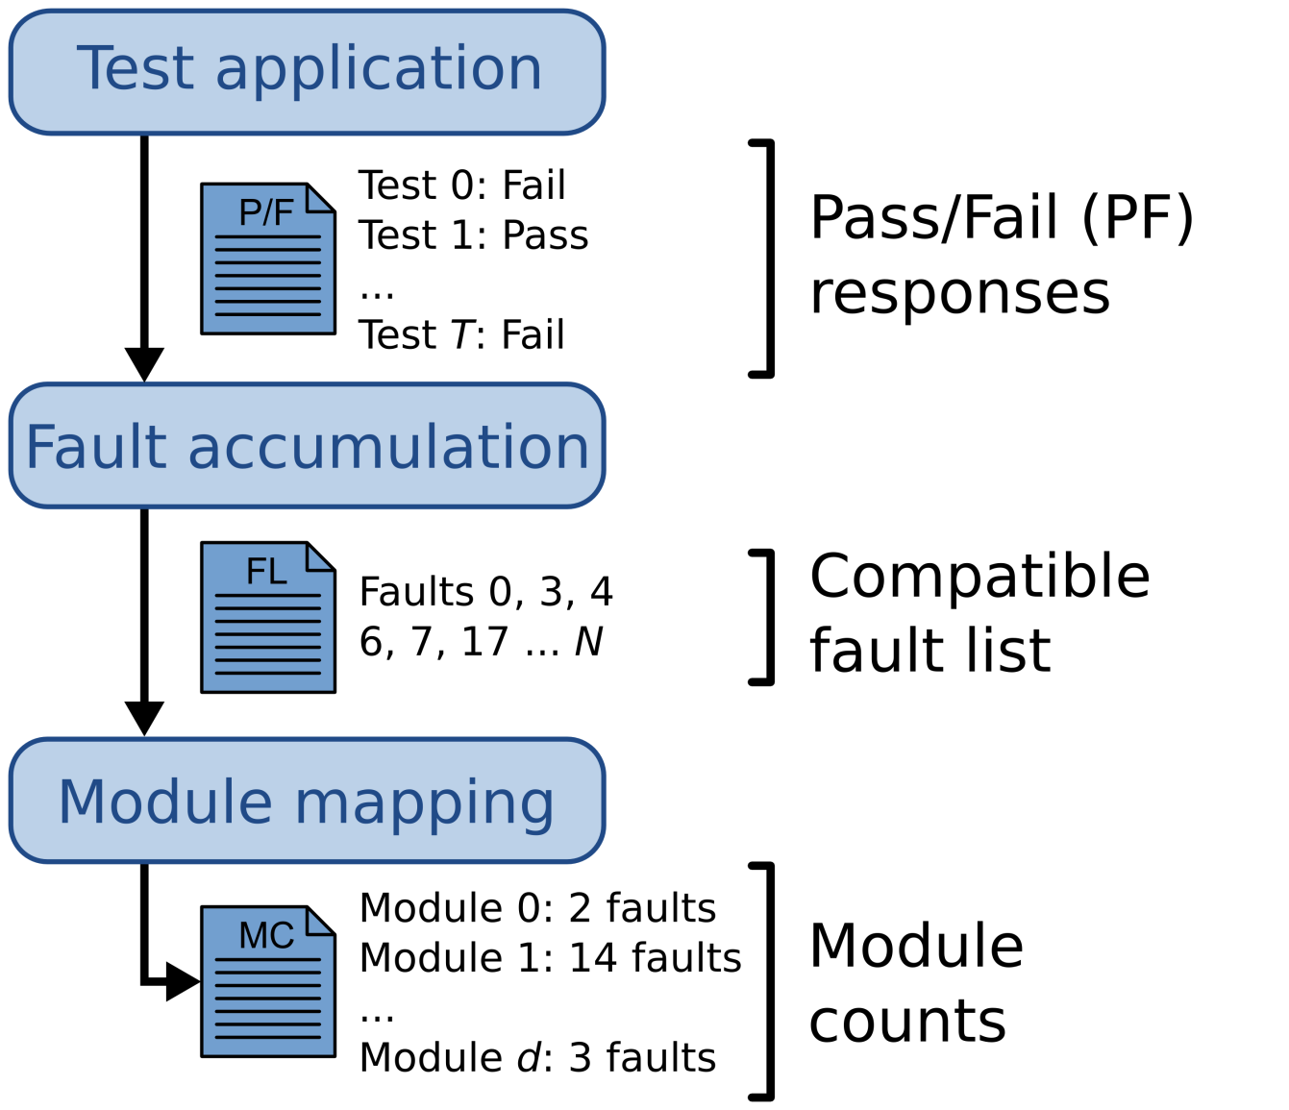
Test and Diagnosis Process
32
Notes:
As I just mentioned, the results of the on-chip test application is a pass/fail response for each applied test. These pass or fail bits are stored in a shift register and later passed to the diagnosis architecture.
The on-chip diagnosis hardware is split into two phases. The first phase performs fault accumulation, where the fault dictionary data is combined with the pass/fail test responses and used to determine which modeled faults are compatible with the observed test responses. A fault is compatible if the modeled behavior (as recorded in the dictionary) does not conflict with the observed pass/fail test responses. The result of this phase is a list of compatible faults, which are passed on to the second phase of diagnosis,
The fault-to-module mapping is the second phase of diagnosis, and uses compatible faults to determine which modules are the most likely location of the failure. For each module, a counter is initialized to zero. For each compatible fault, we determine its module, and increment that module’s counter. When the module mapping phase is complete, we are left with an integer count for each module, indicating the number of compatible faults contained within in each module. The module counts are the final result of the on-chip diagnosis process, and are passed on to the operating system for further decision making.
Next, we will examine the hardware we have designed for performing on-chip diagnosis.

Slide 33
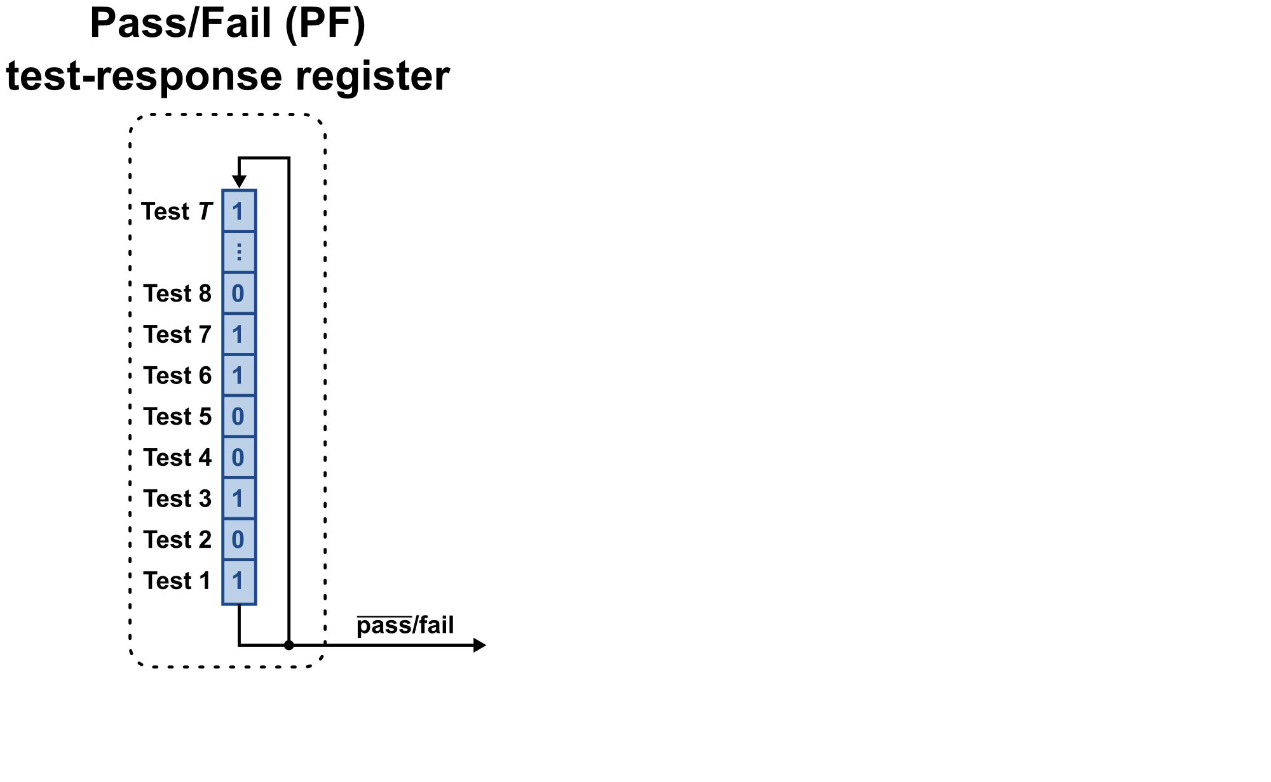
Diagnosis Architecture
33
Notes:
As previously mentioned, the result of the CASP on-chip test is a set of pass/fail bits, one for each applied test. These test result bits are stored in the circular shift register shown here. They can be shifted out one-by-one to the fault accumulator.

Slide 34
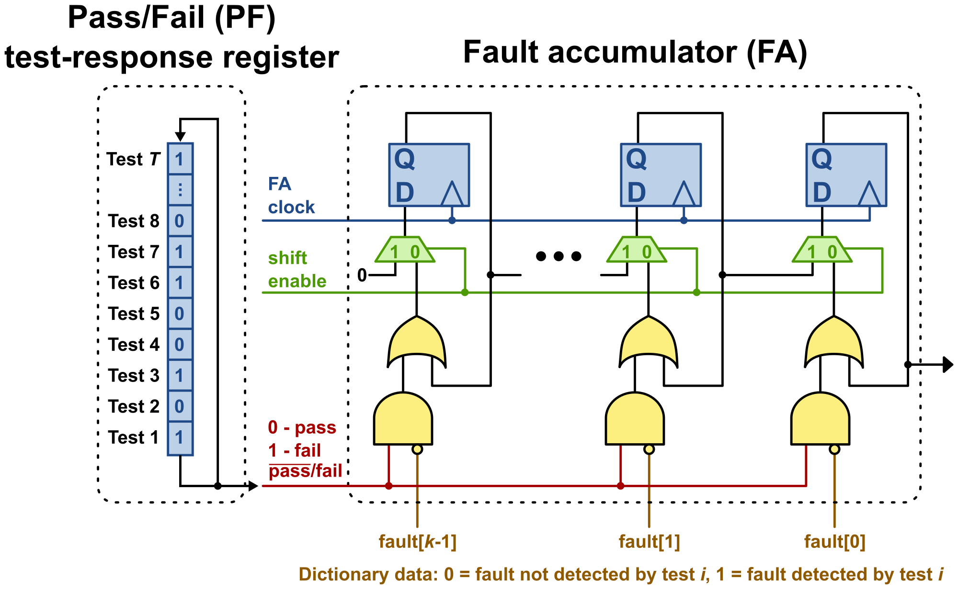
Diagnosis Architecture
34
Notes:
The fault accumulator analyzes the dictionary data along with the pass/fail responses to identify compatible faults. It processes k faults in parallel, storing a zero in each bit position to indicate a compatible fault, and a one to indicate an incompatible fault. This hardware shown here is where the instances of Tester-Fail/Simulation-Pass (TFSP) are identified. After processing all test responses, the fault accumulator enables the serial shift-register path, and transfers this partial-list of compatible fault data to the faulty module identification circuit.

Slide 35
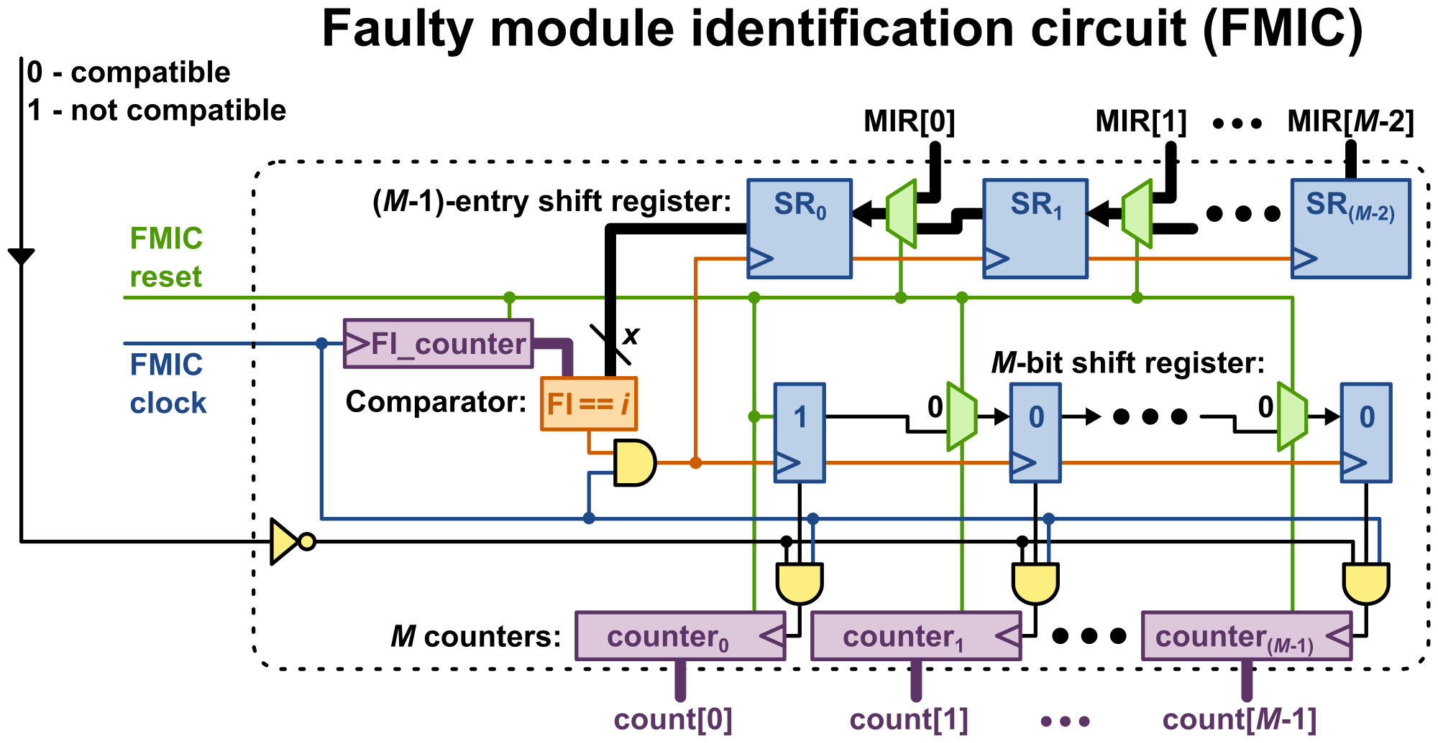
Diagnosis Architecture
35
Notes:
The faulty module identification circuit shown here is responsible for transforming the list of compatible faults into a set of per-module counts. The fault data from the fault accumulator is applied through the air wire shown on the left side of the module. To ease the mapping of faults to modules, we structure the fault dictionary such that the faults are grouped by module., where all the modeled faults belonging to module 1 are shifted-in first, followed by the faults for module 2, and so on. By ordering the faults in such a way, the diagnosis architecture can properly track the associated module for each incoming compatible fault. At the bottom we have the counters that maintain the per-module counts of compatible faults. The comparator determines when the faults shifted in change to the next module in turn. The final result of the on-chip diagnosis process is the set of per-module candidate fault counts at the bottom of this diagram. This result is passed up to the system level for further analysis and decision making.

Slide 36
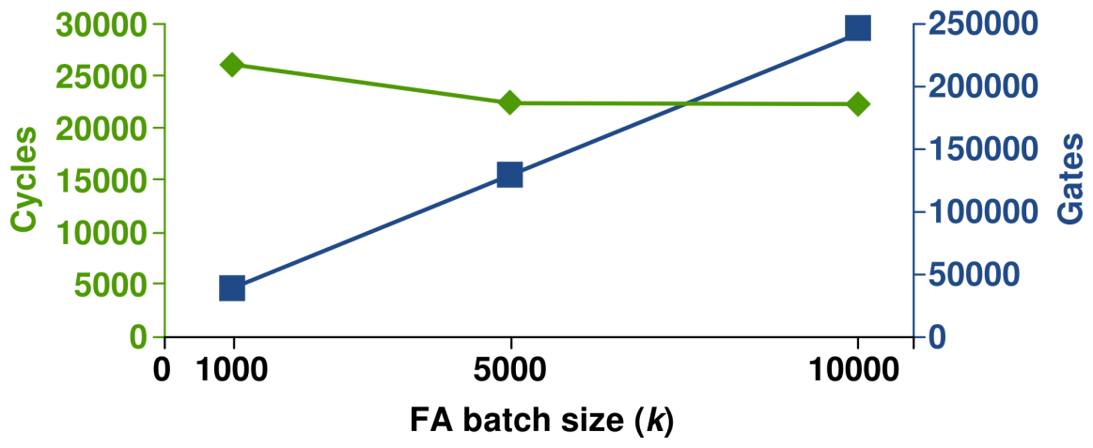
Diagnosis Architecture Overhead
Processing overhead:
About 22,600 cycles for diagnosis (k = 5000)
Area overhead:
(40 × x × M_{max} + 2 × x + 20 × M_{max} + 3) + (16 × T_{max} + 4) + (23 × k)
About 130k gates (i.e., 0.0261% of T2 design) (k = 5000)
Tmax | Max no. of tests | 211
Mmax | Max no. of modules | 10
Fmax | Max no. of faults | 21537
x | log₂(Fmax) | 15
k | No. faults in parallel | 5000
36
Notes:
It is important to analyze the costs incurred by the addition of on-chip hardware for diagnosis. To analyze the overhead, we use the previously-mentioned L2B uncore, which has 211 tests, approximately 21,500 faults, and is partitioned into ten modules. The diagnosis hardware requires about 23 thousand cycles to perform the entire diagnosis, when k = 5000. However, as previously mentioned, after the tests have been applied and responses stored, the circuit-under-test can be returned to normal operation in most cases, meaning that the diagnosis process can then be performed in the background, without causing any performance loss.
In terms of area overhead, we have determined a closed-form expression for the number of gates required to implement the diagnosis hardware. This expression is a function of a few variables. Tmax, Mmax, and Fmax are the maximum number of tests, modules, and faults for any core or uncore, respectively. X is the number of bits required to store a fault index, equal to the log base two of Fmax. k is based on the number of faults that are processed in parallel in the fault accumulator. Processing more faults in parallel requires additional area but requires fewer cycles, so this is a simple trade-off between area and time. For the parameters shown in the table, which are based on the L2B uncore on the OpenSPARC T2, diagnosis requires about 130,000 gates, which is less than 0.0261% of the entire T2 design.

Slide 37
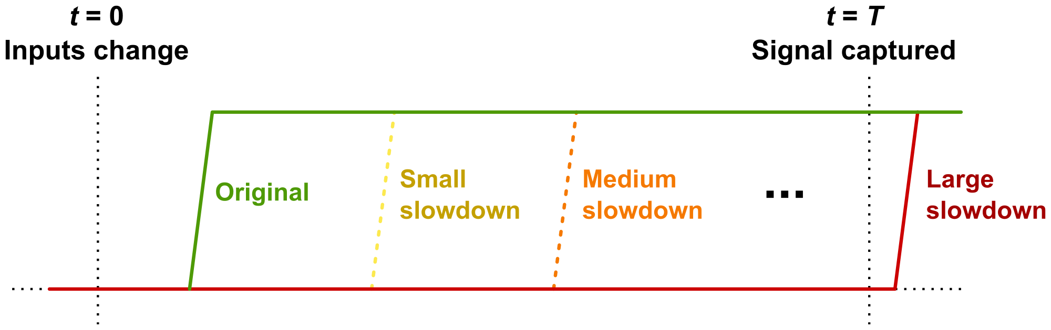
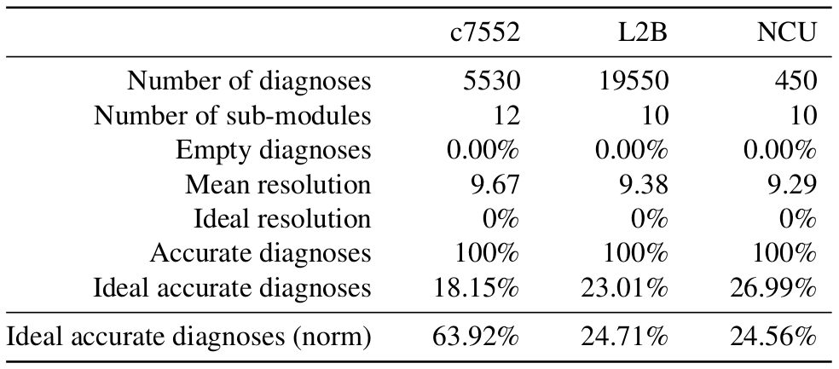
Diagnosis of Injected Delay Defects
37
Notes:
To validate the diagnosis architecture and evaluate the quality of the TRAX dictionary, gate-level simulation is performed to mimic gate slowdown due to early-life and wear-out failures. For each selected defect site, more and more delay is added until at least one incorrect response is observed.
Diagnosis results in a list of per-module candidate fault counts, and these fault counts are evaluated based on our knowledge of the identity of the injected module.
We adapt the conventional metrics of accuracy and resolution for module-based design. Resolution is the number of modules with non-zero fault counts. Ideal resolution occurs when only one module has a non-zero count.
A diagnosis result is accurate if the injected defective module has a non-zero fault count, and is deemed ideal accurate if the defective module has the highest candidate fault count.
Here, we see that for the c7552, L2B, and NCU circuits, that the TRAX fault model fully-covers any delay defect behavior, resulting in no empty or incorrect diagnosis results.
An alternate method of evaluating ideal accuracy of the diagnosis results is shown in the final row of the table. Here, instead of selecting the module with the largest count of candidate faults, we instead normalize the per-module fault counts to the size of each module. This lends additional weight to smaller modules with a higher percentage of candidate faults, so they are not overshadowed by a large module with only a small percentage of candidate faults. This normalization approach did not improve diagnosis results except for c7552 where it showed a great improvement.

Slide 38
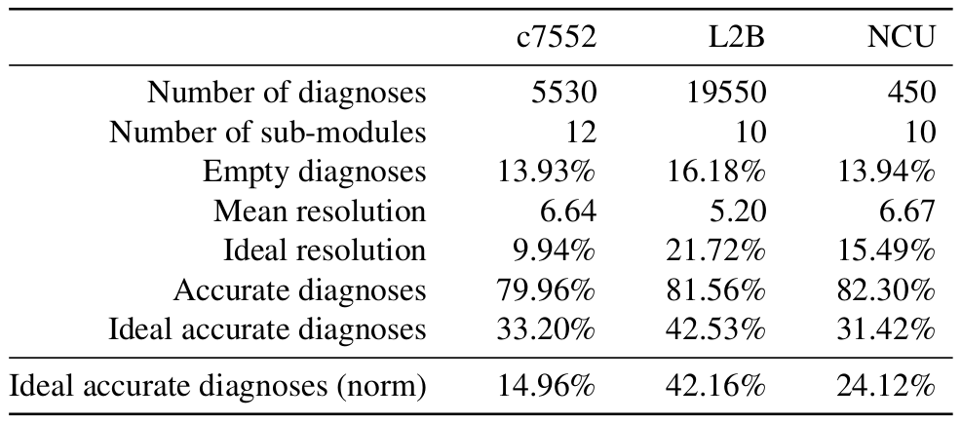
TRAX Hazard Activation
Eliminate hazard activation
Results in some empty/inaccurate diagnoses
Improves ideal accuracy and resolution
38
Notes:
Prompted by the observation of relatively high mean resolution values nearly equal to the number of modules, further fault simulation is performed where the TRAX fault module is slightly modified to disallow fault activation due to hazard values, with results shown here. Due to no-longer encompassing hazard activations, we expected to see an increase in empty and inaccurate diagnosis, and we did observe that. This small reduction in accuracy can be traded for an increase in the ideal accurate and ideal resolution diagnoses and an improvement of the mean resolution.

Slide 39
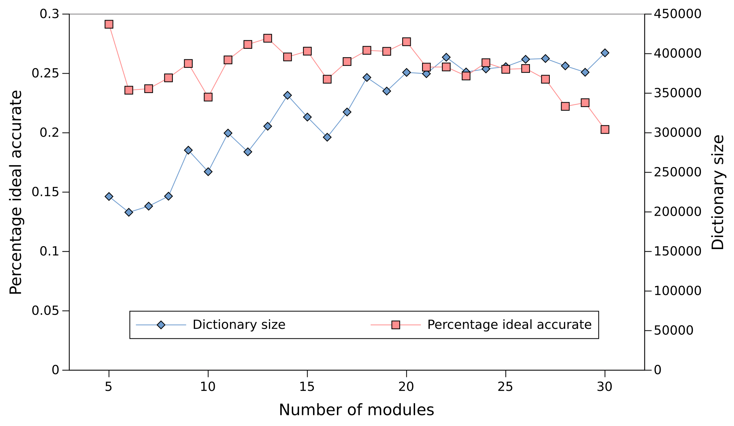
Design Partition Sensitivity
39
Notes:
As previously mentioned, many of the analyzed circuits lack any pre-existing hierarchical structure, and are each partitioned into ten modules using graph-clustering software. Since this choice of 10 modules was relatively arbitrary, we performed an analysis to determine the sensitivity of dictionary characteristics to the number of module partitions. Repeated dictionary construction and diagnosis runs for the L2B circuit are shown here, for partitions between 5 and 30 modules.
As the number of modules used by clustering increases from 5 to 30, there is a slight downward trend in the percentage of ideal accurate diagnosis results, and an upward trend in the size of the fault dictionary.
(if time) While it might be tempting to conclude that a smaller number of modules is better, there is a downside to that not captured in this plot. Essentially, a core or uncore divided into few modules has little robustness against further failures, because the recovery options may have already been utilized, such as swapping-in a spare copy of the module.

Slide 40
On-Chip Diagnosis Summary
TRAX on-chip diagnosis architecture is a scalable low-overhead approach to diagnosis
Tradeoffs in chip area and diagnosis time
Diagnosis of 32,000 injected delay defects show 100% accurate diagnosis results with improved resolution for TRAX-without-hazard
40

Slide 41
Outline
Motivation
Transition-X (TRAX) Fault Model
Hierarchical Fault Dictionary
On-Chip Diagnosis Architecture
Multiple Defect Diagnosis
Defect Injection Site Selection
Evaluating Diagnosis Results
Experiments
Conclusions & Future Work
41

Slide 42
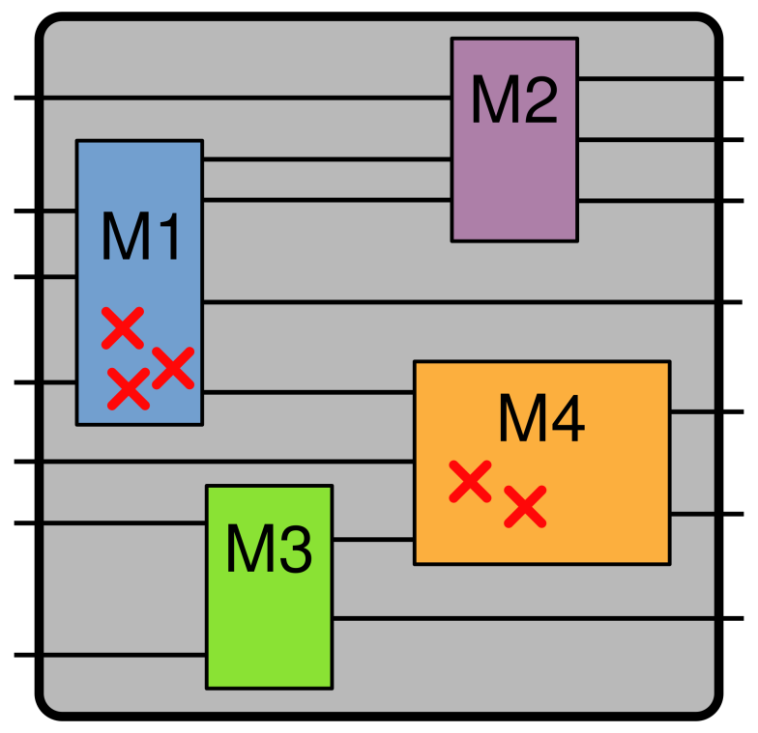
Multiple Defect Injection
TRAX targets single delay defect
Likely to have more than one wear-out or early-life failure
Emulate realistic conditions
Defect injection experiments should emulate realistic defect distributions (locality, usage)
Inject multiple delay defects into test circuits
42
Notes:
= Originally TRAX was designed to target the uncertain delay exhibited by a single delay defect.
= However, it is likely that more than one defect will be present, due to the very nature of the these targeted defect types.
For example, NBTI gradually affects PMOS transistors throughout the circuit over time, depending on their usage. Early-life failures caused by defects from fabrication variation are likely to occur in clusters based on that variation, leading again to a circuit afflicted by more than one defect.
= We want to evaluate how well the TRAX on-chip diagnosis process works when facing multiple injected defects.
= As part of this, we want to provide a more realistic defect site selection to try and emulate more-realistic situations.
= In this section, we perform a series of multiple defect injection experiments. We’ll discuss how to provide for a realistic selection of defect sites, how the evaluation of diagnosis results changes when multiple modules are defective, and show results from the diagnosis experiments.

Slide 43
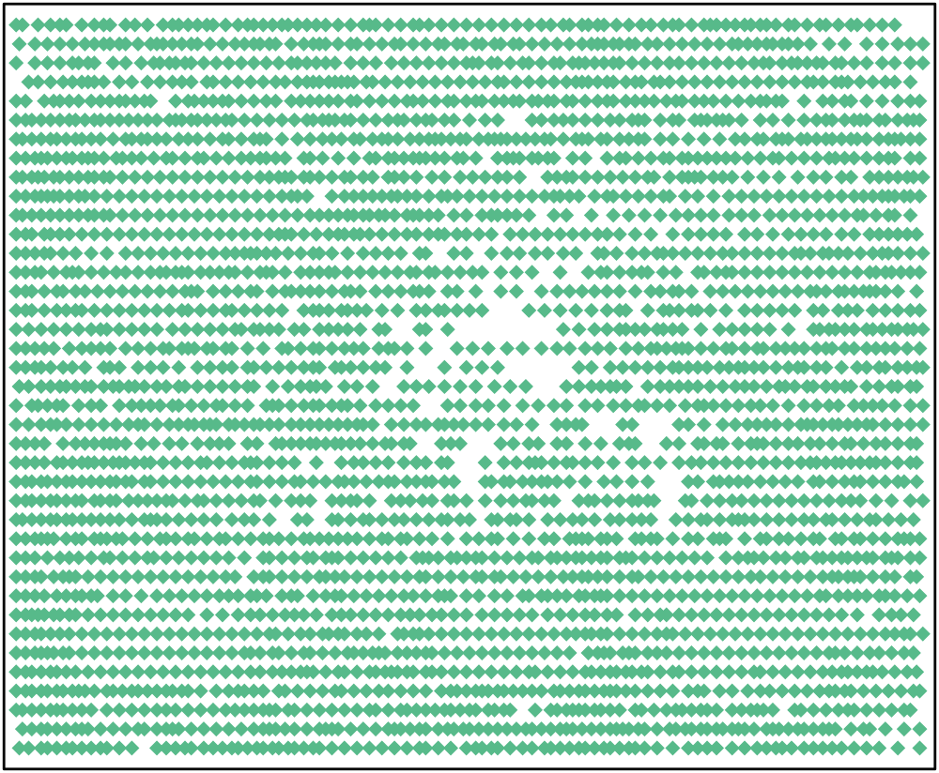
Locality-based Defect Selection
Defects caused by process variation will show clustering
Commercial place-and-route tool builds gate placement file
Select random gate and fault polarity, select k neighbors, inject TRAX delays
Gate placement for circuit c7552
43
Notes:
Early-life failures such as gate oxide defects are caused by fabrication defects due to natural variation in the IC fabrication process. If process variation creates a gate oxide defect at a particular location, we are likely to find other such defects in close proximity.
We used a commercial place-and-route tool with each circuit to estimate the approximate coordinate positions of each gate within the design placement. An example placement for benchmark circuit c7552 is shown here.
To perform a locality-based multiple defect injection experiment, we select a random gate and fault polarity (either STR or STF), then we select its k nearest neighbors, and inject the corresponding TRAX delays. We then diagnose the circuit response from gate-level simulation.

Slide 44
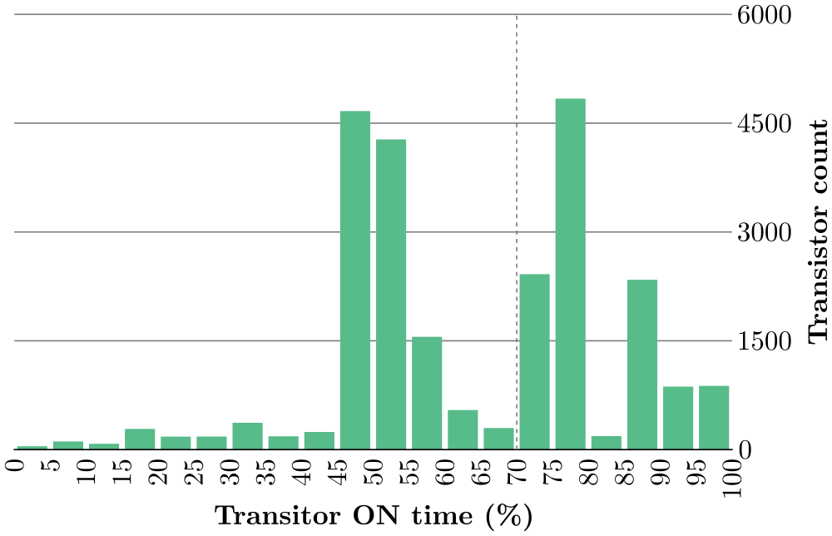
Usage-based Defect Selection
Defects caused by PMOS transistor ON-time (usage)
Instrumented GPU-fault sim, 100k tests
Filter-out PMOS less-than 70% ON
Select k damaged PMOS, inject TRAX rise delay into gate
Histogram of PMOS transistor ON-times for circuit L2B.
44
Notes:
As mentioned, NBTI damages PMOS transistors based on how often they are turned on. To try and estimate the damage of the PMOS transistors in each circuit, we instrumented the GPU fault simulator to track how often each PMOS transistor is turned on, while we apply 100,000 random test vectors. The plot here is a histogram showing the distribution of PMOS transistor on-time for the L2B circuit. We see that many of the transistors, well over half, are turned on about 50% of the time, which seems quite reasonable when exercised by a random test set.
We chose 70% on-time as our NBTI damage threshold, and select k damaged transistors and inject the corresponding TRAX delays. We then diagnose the circuit response from gate-level simulation.

Slide 45
Evaluation of Diagnosis Results
Single Defect Diagnosis
Accurate: Defective module has non-zero candidate fault count
Ideal-Accurate: Defective module has highest count
Multiple Defect Diagnosis
Accurate: All defective modules have non-zero candidate fault counts
Ideal-Accurate: All defective modules have counts >= largest non-defective module count
Partial-Accurate metric: % of defective modules with non-zero candidate fault counts
45
Notes:
As mentioned before, the on-chip diagnosis process has two phases. First, we use the fault dictionary with the list of failing tests to filter out any modeled faults that are not compatible with the observed test failures. Then we analyze each of these candidate faults to determine which module it belongs to, and build up a count of compatible faults for each module.
To evaluate the quality of the diagnosis results, we analyze the set of per-module fault counts. When there is only a single injected defect there is only a single defective module we are trying to find. If that defective module has a non-zero candidate fault count, we deem the diagnosis result as Accurate. If the defective module has the highest fault count (or is tied for the highest count), we deem that ideal-accurate.
Things change a bit when there are multiple injected defects, and possibly multiple defective modules. An accurate diagnosis is one where all defective modules have a non-zero candidate fault count. Ideal accuracy occurs when all defective modules have counts great than or equal to the largest non-defective module count. This one is a bit confusing and we’ll explain more on the next slide.
For the multiple defect case, we also added a new metric called Partial-Accuracy. This is how we can try to evaluate the situation where some but not all of the defective modules have a non-zero fault count. For example, if there are five defective modules and only three of five have non-zero fault counts, we call that 60% partial accuracy. We’ll work through a couple examples next.

Slide 46
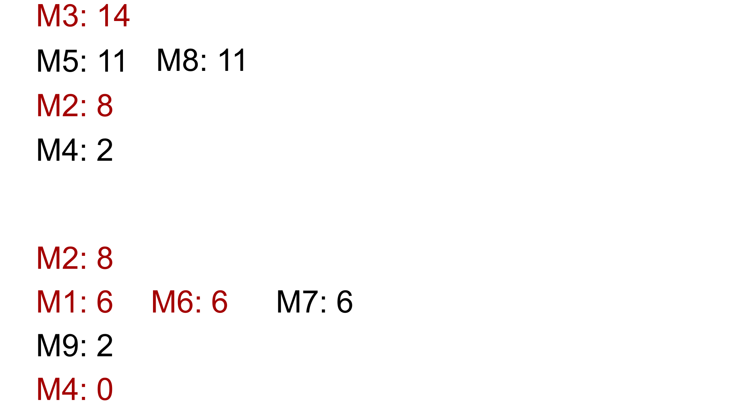
Evaluation of Diagnosis Results
46
Notes:
Here are two examples of how diagnosis result evaluation changes with multiple defective modules.
In the upper example, there are two defective modules highlighted in red, and five modules with non-zero fault counts.
For the lower example, there are four defective modules, and six modules with non-zero fault counts.
The modules in each example are sorted top-to-bottom based on their count of candidate faults.

Slide 47
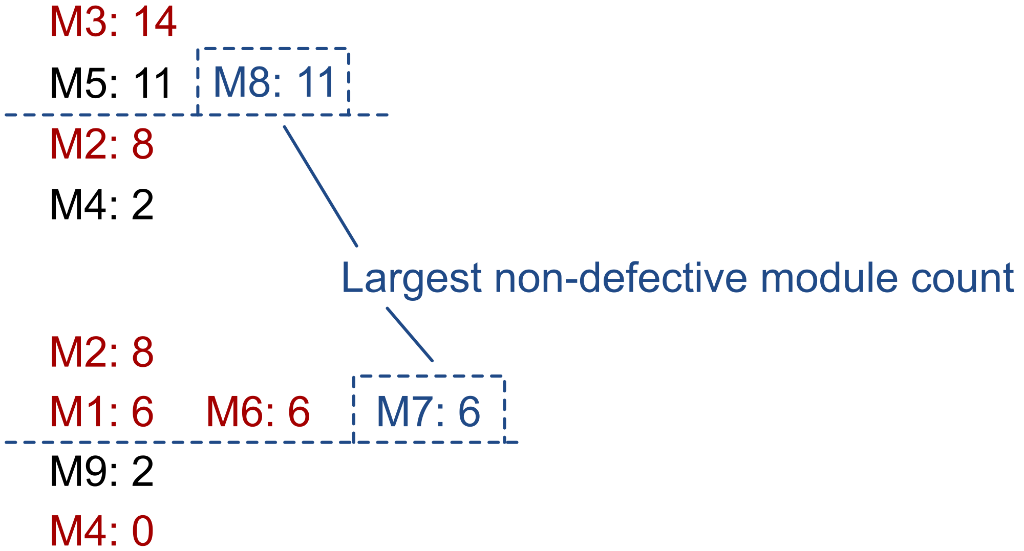
Evaluation of Diagnosis Results
47
Notes:
The first step is to determine the “largest non-defective module count” for each diagnosis result. For the upper example, this would be the count eleven, and the lower example is count 6. We draw a dashed line under the largest non-defective module count to indicate the boundary for ideal accuracy.

Slide 48
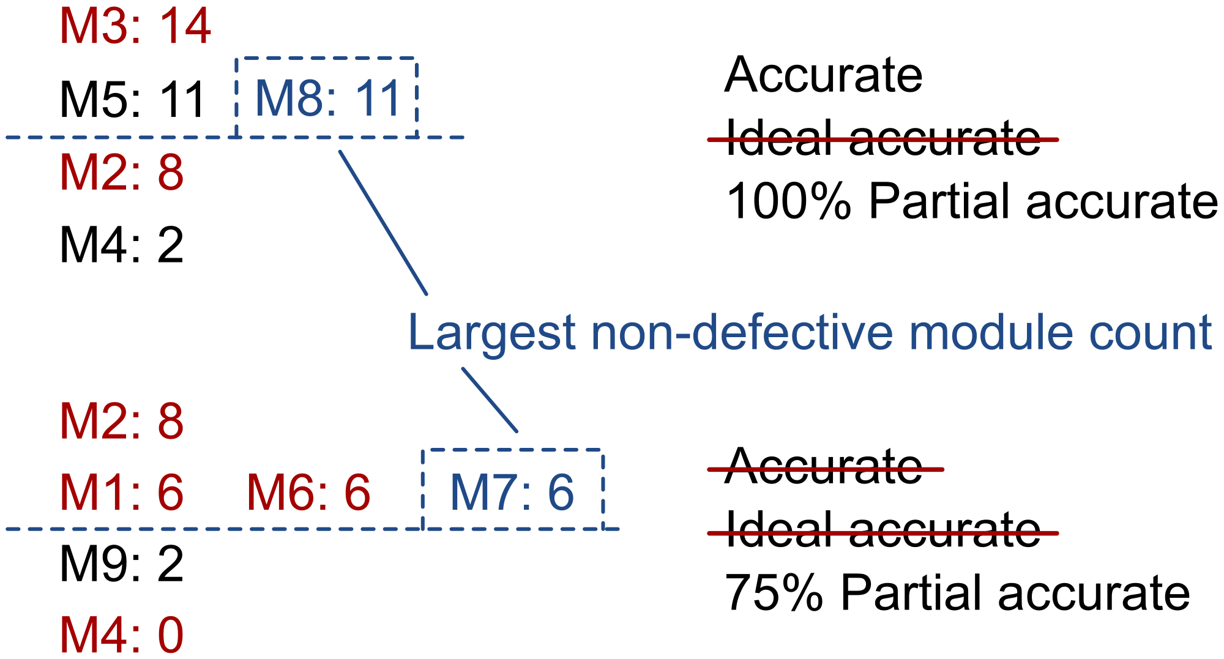
Evaluation of Diagnosis Results
48
Notes:
In the upper example, both defective modules have non-zero fault counts, so the diagnosis is deemed Accurate (equivalent to 100% partial accurate). However, since one of the defective modules is ranked lower than a non-defective module, it is not ideal accurate.
The lower example has a defective module, M4 at the bottom, with zero candidate faults, meaning that this diagnosis is not deemed accurate, and is therefore also not ideal accurate. Here, the partial accuracy measure has some utility to show us how many defective modules were properly called-out as defective. Here, three of four defective modules have non-zero fault counts, so the partial accuracy is 75%.

Slide 49
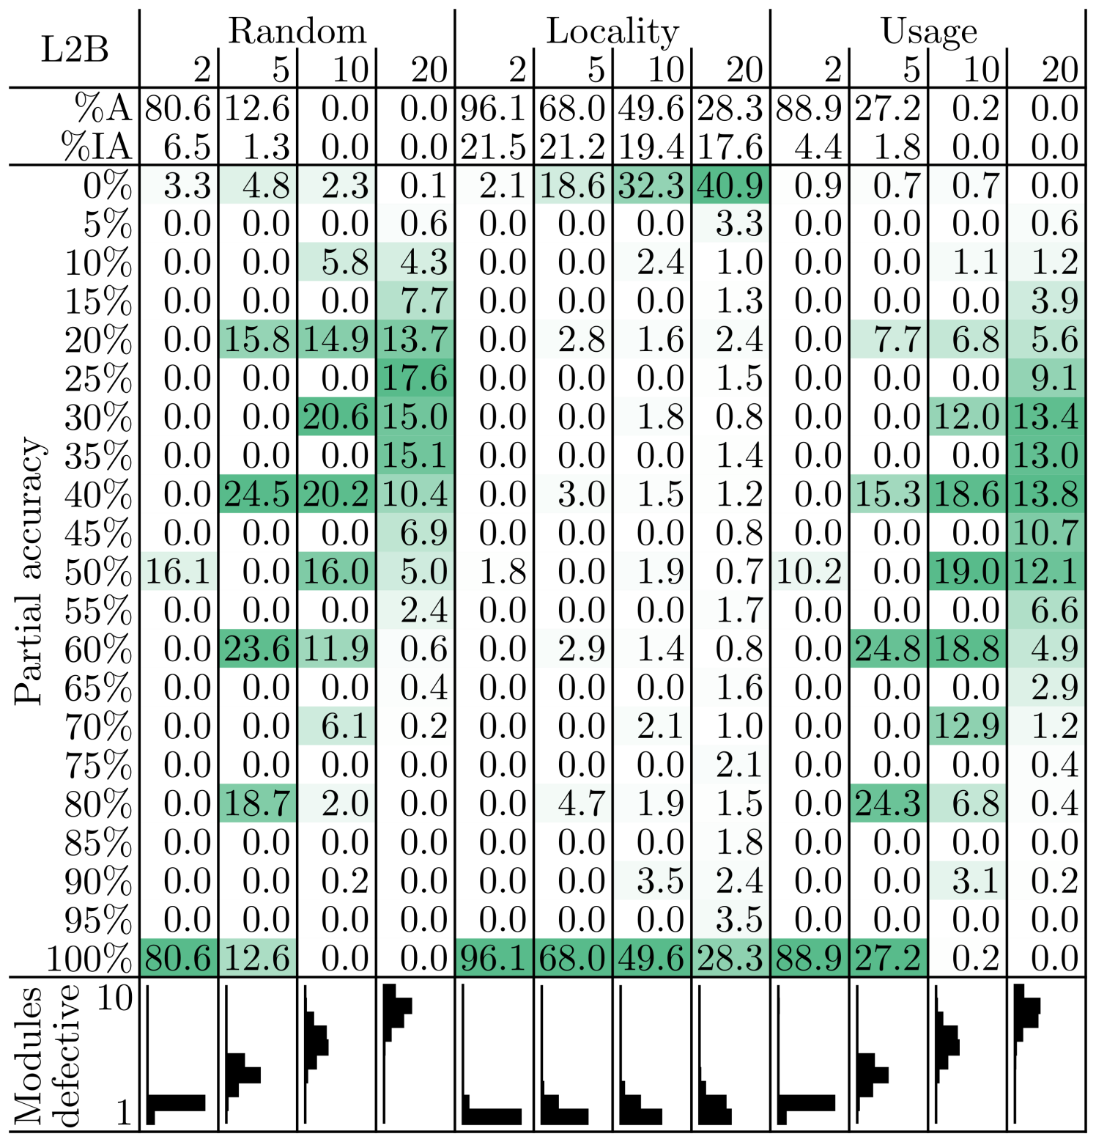
Experiment Results
49
Notes:
Twelve groups of defect injection experiments are performed for each of the three circuits analyzed, with 1,000 defect injections for each group. Results from L2B are shown here. The 12 experiment groups are divided into four groups each for random-based, locality-based, and usage-based defect injections. For each of these three groups, experiments are run with 2, 5, 10, and 20 injected defects.
The first two rows are the percent accurate (%A) and percent ideal accurate (%IA), followed by the partial accuracy histogram, which is shaded to highlight the larger bins, with
darker background color indicating a higher percentage of diagnosis results. Below the partial accuracy histogram is a small plot showing the distribution of the
number of defective modules.
TODO

Slide 50
Multiple Defects Summary
Evaluation of on-chip diagnosis for localizing multiple injected defects
Random-, locality-, and usage-based defect site selection
Effective diagnosis of two injected defects
50

Slide 51
Overall Summary
TRAX Fault Model
Captures uncertainty of delay defects
GPU-accelerated fault simulation
Hierarchical Fault Dictionary
Exploits module-level hierarchy for relaxed diagnosis
Eliminates faults via equivalence and subsumption
On-Chip Diagnosis Architecture
Low-overhead diagnosis architecture hardware
Scalable design enables size vs. cycles tradeoff
Multiple Defect Diagnosis
Realistic defect-site selection for defect injection
51

Slide 52
Future Work
TRAX-aware automatic test pattern generation
Explore variants of TRAX fault model
GPU simulator performance improvements
Usage-based defect injection workload
Adaptive TRAX on-chip test and diagnosis
52

Slide 53


Conclusions
Computers are fantastic devices
Notes:
To conclude, computers are fantastic devices, we are so fortunate to be able to use them in our work, and to use them to make the world a better place.
Nowadays we’re all constantly surrounded by dozens and hundreds of computers and chips; It’s easy to forget about how cool it all is, to forget about the magic that we get to play with.
I want to end with two quotes that have stuck with me, from, or all places, two random people on twitter.
It really seems to be a process worthy of frankenstein himself: We take plain old sand, one of the most common and boring materials on the planet, then purify it to its elemental form. We pattern it not with ancient runes but with modern sigils, bombard it with trace impurities, and finally imbue it with lighting. How cool is that.

Slide 54
Publications
M. Beckler, R. D. Blanton, “Evaluation of Transition-X Fault Model for On-Chip Diagnosis of Multiple Defects," submitted for review to International Test Conference, 2017.
M. Beckler, R. D. Blanton, “On-Chip Diagnosis of Generalized Delay Failures using Compact Fault Dictionaries," submitted for review to IEEE Transactions on Computer-Aided Design of Integrated Circuits and Systems, 2017.
M. Beckler, R. D. Blanton, “GPU-Accelerated Fault Dictionary Generation for the TRAX Fault Model," invited paper to appear in proceedings of International Test Conference, 2017.
M. Beckler, R. D. Blanton, “GPU-Accelerated Fault Dictionary Generation for the TRAX Fault Model," to appear in proceedings of International Test Conference in Asia, 2017.
M. Beckler, R. D. Blanton, “On-chip Diagnosis for Early-life and Wear-out Failures," International Test Conference, 2012.
54

Slide 55
Acknowledgements
Thesis committee:
Prof. Shawn Blanton Prof. Ken Mai
Prof. Diana Marculescu Prof. Subhasish Mitra
Fellow members of ACTL for research help, especially Ben, Harsh, and Soumya.
The work in this dissertation was supported by the Semiconductor Research Corporation through contract no. 1974.001, the National Science Foundation under contract no. 0903478, as well as the Lamme/Westinghouse and Bertucci Graduate Fellowships
55

Slide 56
Thank you!
56

